Slide 1



Healthcare Reform and Immigration Status in California
May 13, 2014

Slide 2


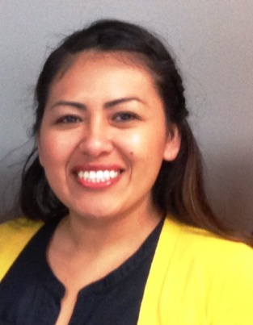
Speakers
Kellen Russoniello, Staff Attorney – Health and Drug Policy, ACLU of San Diego & Imperial Counties
Gabrielle Lessard, Health Policy Attorney, National Immigration Law Center
Betzabel Estudillo, Health Policy Coordinator, California Immigrant Policy Center

Slide 3
Basics of the Affordable Care Act
Kellen Russoniello
Staff Attorney – Health and Drug Policy
ACLU of San Diego and Imperial Counties
krussoniello@aclusandiego.org
May 13, 2014

Slide 4
ACLU of San Diego and Imperial Counties
We fight for individual rights and fundamental freedoms for all through education, litigation, and policy advocacy
Focus areas:
  Immigrants’ Rights
  Criminal Justice and Drug Policy Reform
  Voting Rights
Overlap of ACA and Criminal Justice System

Slide 5
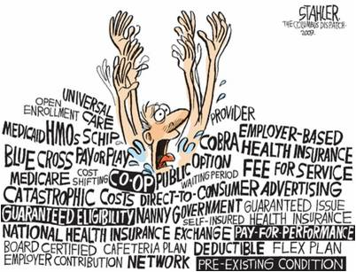
Overview
Medi-Cal Expansion
Covered California
Residency
Individual Mandate and Exceptions
Open Enrollment and Special Enrollment Periods

Slide 6

Medi-Cal Expansion
Provides health coverage to low-income residents
Expanded Jan. 1, 2014 to cover most adults <65 years of age with incomes at or below 138% FPL
  $16,105 for an individual
  $32,913 for a family of four
Eligibility for new population based on projected annual income (MAGI); assets not considered
Full-scope vs. Restricted-scope
Notes:
Medicaid is a joint federal and state funded program. States administer the program and must conform to federal regulations. States must cover certain categories, such as aged, blind, disabled, and pregnant women and children. In California, Medicaid is called Medi-Cal. CA covers most optional categories and provides state-only funding for categories that the federal government won’t pay for, such as lawfully present people who have been in the US under five years. Under the ACA and the Supreme Court ruling in 2012, Medicaid expansion became optional for states. California was one of the first states to expand.
250% FPL = $59,625 for a family of four
MAGI applies to newly eligible, parents, children, and pregnant women. Coverage for certain categories will remain higher than 138% FPL. Children are eligible if household income is at or below 250% FPL = $59,625 for a family of four.
Full-scope Medi-Cal is available where all eligibility requirements are met, including immigration status. This gives the full range of coverage, including hospitalizations, outpatient treatment, prescription drugs, mental health and substance use disorder treatment, and so on. Limited, restricted, or emergency scope Medi-Cal is available to those who meet income and residency requirements but are ineligible for full-scope coverage due to immigration status. Limited-scope Medi-Cal provides coverage for emergency, pregnancy-related services, and renal dialysis.

Slide 7
Covered California
California’s Health Benefit Exchange
One-stop shop for insurance plans, including Medi-Cal (no wrong door)
Four levels of plans based on actuarial value
Advanced premium tax credits for 100%-400% FPL
  Lowers cost of monthly premium
  Credit equals premium minus percentage of income
  Percentage ranges from 2% to 9.5%
Additional cost-sharing subsidies (silver plan only)
Notes:
Bronze, Silver, Gold, Platinum
Cost-sharing reduction:
Reduction of annual cost-sharing up to 400% FPL (2/3 100%-200%, ½ 201%-300%, 1/3 301%-400%
Reduction of out-of-pocket expense at time of service up to 250% FPL.
100% FPL = $11,6700 for an individual and $23,850 for a family of four
400% FPL = $46,680 for an individual and $95,400 for a family of four

Slide 8

Covered California Cont.
If eligible for Medi-Cal, not eligible for Covered CA
If you are lawfully present and would be eligible for Medi-Cal but for immigration status, you are eligible for coverage through Covered CA.
  If your income is below 100% FPL, you will be eligible for the same amount of financial assistance as if your income was 100% FPL
Notes:
Example is a non-immigrant status, such as temporary worker or student

Slide 9
Residency
Requirement for Medi-Cal and Covered California
Live in California and:
  Have the intent to remain indefinitely, or
  Entered the state with a job commitment or to seek employment.
Different than immigration status (e.g., can be a resident and undocumented)
May be more difficult to prove for non-immigrant statuses (especially Medi-Cal)
Notes:
Cannot own or lease a principle residence outside CA. A person’s declaration along with residency evidence submitted shall be accepted as proof of residency unless there is evidence to the contrary. This may present problems where a person’s visa will expire after a certain term.

Slide 10
Individual Mandate
Most people must have coverage or pay a penalty
  2014 - $95 per adult/$47.50 per child (up to $285) or 1% family income,* whichever is greater
  2015 - $325 per adult/$162.50 per child (up to $975) or 2% family income,* whichever is greater
  2016 - $695 per adult/$347.50 per child (up to $2,085) or 2.5% family income,* whichever is greater
Pro-rated by number of months w/o coverage
* Maximum is national average premium for a bronze plan
Notes:
All citizens, permanent residents, and foreign nationals in the US long enough to qualify as resident aliens under tax law must have minimum essential coverage.
Coverage on one day of the month is sufficient to avoid the penalty for that month. If you are exempt one day out of the month, the whole month is exempt.

Slide 11
Exceptions to Individual Mandate
Not lawfully present
Not a “resident alien” under federal tax law
Religious objection
Incarcerated
Member of Indian tribe
Income below tax filing threshold ($10,150 for an individual and $20,300 for a married couple filing jointly)
Insurance more expensive than 8% of income
Insurance gap of less than 3 months
Hardship (e.g., homelessness, death of family member, financial hardship)
Notes:
Resident alien – not so much an exemption as in the definition of who the mandate applies to. Nonetheless, if you are not considered a resident alien, then you do not have to pay the mandate if you do not have coverage. There are two tests to determine if you are a resident alien (you must pass only one):
The first test is the "green card test." If at any time during the calendar year you were a lawful permanent resident of the United States, and this status has not been rescinded or administratively or judicially determined to have been abandoned, you are considered to have met the green card test.
2. To meet the “substantial presence test,” you must have been physically present in the United States on at least:
1. 31 days during the current year, and
2. 183 days during the 3 year period that includes the current year and the 2 years immediately before. To satisfy the 183 days requirement, count:
All of the days you were present in the current year, and
One-third of the days you were present in the first year before the current year, and
One-sixth of the days you were present in the second year before the current year.
Migrant workers: Days you commute to work in the United States from a residence in Canada or Mexico if you regularly commute from Canada or Mexico do not count. You are considered to commute regularly if you commute to work in the United States on more than 75% of the workdays during your working period.
Even if you meet the substantial presence test, you can be treated as a nonresident alien if you are present in the United States for fewer than 183 days during the current calendar year, you maintain a tax home in a foreign country during the year, and you have a closer connection to that country than to the United States.
Students and teachers temporarily in the US on visa are exempt from treatment as resident aliens for a certain amount of time.

Slide 12
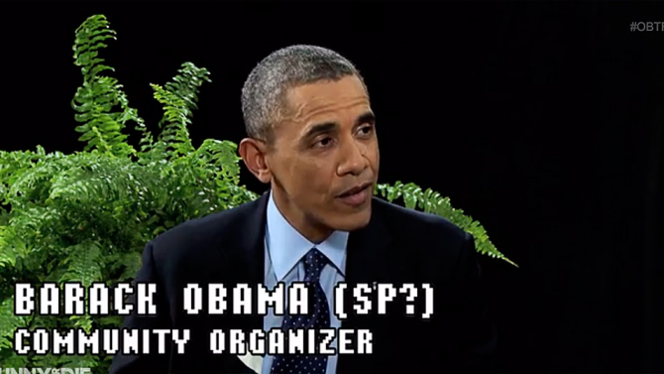
Open Enrollment
NO OPEN ENROLLMENT PERIOD FOR MEDI-CAL!
  Can apply at any point throughout the year
First open enrollment for Covered CA ended March 31, 2014
The next open enrollment period is November 1, 2014 – February 15, 2015

Slide 13
Special Enrollment Periods
60 day enrollment period triggered by Qualifying Life Event:
  Become a citizen, national, or lawfully present person
  Loss of coverage
  Marriage/domestic partnership
  Change of address resulting in new plans available (including release from incarceration)
  Change in income
  Have or adopt a child, or place a child in adoption/foster care
  Applied before March 31 but denied Medi-Cal after March 31
  Wrong enrollment due to Covered CA, insurance, or CEC
  Case-by-case decision
Notes:
Loss of coverage = due to losing job-based coverage, divorce, the end of an individual policy plan year in 2014, COBRA expiration, aging off a parent’s plan, losing eligibility for Medicaid or CHIP, death of policy holder, and similar circumstances
For changes in income, you must have been enrolled in a plan before the change in order to take advantage of an SEP.

Slide 14
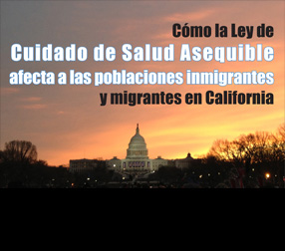
Resources
ACLU: ACA & Immigrants
  ACLU and CIPC Fact Sheet in English and Spanish
  ACLU “Cheat Sheet” – English and Spanish
IRS: Information on Individual Mandate
Center on Budget and Policy Priorities: Special Enrollment Periods and Exemptions
National Health Law Program

Slide 15
Immigrants and health care In
California
Gabrielle Lessard
National Immigration Law Center

Slide 16
National Immigration Law Center
Our mission is to defend & advance the rights & opportunities of low-income immigrants and their family members.
We envision a U.S. society in which all people - regardless of their race, gender, immigration or economic status - are treated equally, fairly, and humanely, have equal access to justice, education, government resources and economic opportunities, and are able to achieve their full potential as human beings.

Slide 17
ROAD MAP
Immigrants in California
Eligibility Requirements
Barriers

Slide 18
Immigrants in California
Highest Share in US:
    10.3 million foreign born (27% of state pop.)
    4.8 million naturalized citizens (47% of immigrants)
    ~2.3 million undocumented (7% of state pop.)
    ~23% of national undocumented population
Notes:
Mixed status families

Slide 19
Mixed-Status Families
In Families with Citizens:
  Half of California children have at least one immigrant parent
    90.4% of these kids are citizens
  13% of California children have an undocumented parent

Slide 20
Insurance and Health Care Access
Immigrants are more likely than the US-born to be uninsured
Immigrants use fewer health care services than U.S. citizens with the same insurance status (MPI, 2013)
Undocumented immigrants use fewer health care services than citizens and lawful permanent residents with the same insurance status (UCLA, 2014)
Notes:
Fewer services when compared with USC with same insurance status Source, Migration Policy Institute, health Care for Immigrant Families: Current Policies and Issues (June 2013).

Slide 21
ROAD MAP
Immigrants in California
Eligibility Requirements
Barriers

Slide 22
Immigration Process
Noncitizens enter the US lawfully:
  As immigrants on a path to lawful permanent resident (LPR) status
  As nonimmigrants admitted for a temporary stay
  As refugees admitted because they face persecution due to race, religion, nationality, political opinion, or membership in a particular social group
    Can adjust to LPR status
    Asylees are similar to refugees but apply for the status
    after entering the US

Slide 23

Undocumented Immigrants
Entered without inspection
Stayed past the expiration of a temporary visa

Slide 24
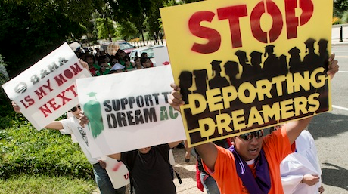
Deferred Action for Childhood Arrivals
Deferred Action for Childhood Arrivals (DACA)
  Undocumented immigrants who arrived in U.S. before age 16 (“Dreamers”)
  Enrolled in or completed education leading to employment
  Continuously present since
  June 15, 2007

Slide 25
Coverage Options in CA
Covered California – state health insurance marketplace/exchange
    Premium tax credits for families earning up to <400% FPL, and cost-sharing reductions for <250% FPL
Medi-Cal expansion – to 138% of federal poverty level (FPL)
Other safety net programs
  E.g., federally-qualified health centers (FQHCs), community clinics, migrant health clinics, public hospitals, charity care
Notes:
Each has their own immigrant eligibility rules

Slide 26
Federal Benefits Eligibility
In 1996, Congress divided lawfully present immigrants into two categories for federal benefits eligibility purposes:
      “qualified” and “not qualified”
Qualified Immigrants can receive federal benefits, but many are barred from receiving federal benefits until they have been in the U.S. for five years
  California uses state funds to provide benefits during this ‘five year bar’
Notes:
as part of the Personal Responsibility and Work Opportunity Reconciliation Act (PRWORA),

Slide 27
Qualified Immigrants
Lawful Permanent Residents (LPR)
Refugees
Asylees
Certain domestic violence survivors and their family members
Certain trafficking survivors and their family members
  Iraqi or Afghani special immigrants (worked for US)
Notes:
Demonstrates that they were persecuted or fear persecution due to race, religion, nationality, political opinion, or membership in a particular social group

Slide 28
More Qualified Immigrants
Other humanitarian entrants:
  Persons granted withholding of deportation or removal
  Certain conditional entrants (granted before 4/1980)
  Certain Cuban/Haitian entrants
  Humanitarian and Public Interest Parolees
  For a full list, see “‘Lawfully Present’ Individuals Eligible under the Affordable Care Act” at http://nilc.org/document.html?id=809

Slide 29
State Flexibility
Under the “unborn child” option in CHIP, states can opt to provide prenatal services to pregnant women regardless of immigration status
States can use their own funds to provide Medicaid/CHIP to:
  Qualified immigrants during the five year bar
  People Permanently Residing Under Color of Law (PRUCOL)
California has exercised all of these options

Slide 30
Eligibility for Covered California
Lawfully Present
Qualified
lawfully present immigrants are eligible to purchase health coverage through state health care marketplaces
no five-year bar
exception:
People who received deferred action through DACA are specifically excluded

Slide 31
Lawfully Present Immigrants
All “qualified” immigrants
People with permission to stay in the U.S. indefinitely
  temporary protected status (TPS)
  most with deferred action
Applicants for LPR and certain other statuses
People with valid nonimmigrant status not in violation of the terms of their visas
Complete list:
https://www.healthcare.gov/immigration-status-and-the-marketplace/

Slide 32
DACA
Excluded from access to federally-facilitated, partnership, and state-run marketplaces/exchanges
  No premium tax credits and cost-sharing reductions
  Exempt from the individual mandate
No access to federally-matched Medicaid and CHIP
California classifies DACA recipients as PRUCOL
  Can receive Medi-Cal if otherwise eligible
For FAQ on DACA and Access to Health Care see http://nilc.org/acadacafaq.html

Slide 33
Undocumented Immigrants
Undocumented residents can receive restricted-scope Medi-Cal
Remain eligible for health programs that are available regardless of immigration status (e.g., public health programs)
Hospitals must still provide emergency care regardless of insurance or immigration status
Community health centers can continue to provide non-emergency health care regardless of immigration status
Eligible to be covered by employer-sponsored group health insurance
Insurance companies may offer insurance policies outside the state exchange(s) that are available to undocumented

Slide 34
CA Programs Available Regardless of Status
Emergency Medi-Cal
Prenatal care (Medi-Cal)
Access for Infants and Mothers (AIM)
Long-term care
Early Breast Cancer Detection
Breast and Cervical Cancer Treatment
California Children’s Services (CCS)
Children’s Health Initiatives
Health Programs in some counties (Healthy SF, Healthy Way LA Unmatched)
Community clinics
Child Health and Disability Prevention Program (CHDP) and CHDP “Gateway”
Family PACT
Minor consent services
Mental health services
Regional Center Services
Women Infants and Children (WIC)
School lunch and breakfast

Slide 35
ROAD MAP
Immigrants in California
Eligibility Requirements
Barriers

Slide 36

Barriers
Lack of information/misinformation
  Concern that receiving benefits or having medical debt will interfere with ability to adjust immigration status (“public charge”)
  Fears about jeopardizing family members
  Belief that benefits will need to be repaid
Confusion about eligibility
Problems in application process
Language barriers

Slide 37
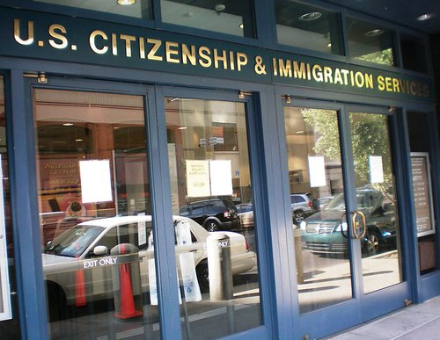
Public Charge
A “public charge” is a person considered primarily dependent on the government for subsistence, as demonstrated by:
  receipt of public cash assistance for income maintenance or
  institutionalization for long-term care at government expense
A person who is found likely to become a public charge may be denied:
  Admission to the U.S., or
  Lawful permanent resident status
Public charge is not a concern for:
  Medical benefits other than long-term care
  Other non-cash benefits (e.g., SNAP)
  People who are already LPRs

Slide 38
Verification
Citizenship or lawful presence is verified for all applicants
Status is verified electronically through:
  Social Security Administration (SSA) for citizens.
  U.S. Citizenship and Immigration Services (USCIS) for noncitizens via the Systematic Alien Verification for Entitlements (SAVE) database.
Income is verified electronically by the IRS
    If unable to verify status or income electronically, enrollees have an opportunity to provide other documents by upload, mail or fax.

Slide 39
SSNs
Only individuals who are applying for benefits are required to provide their immigration/citizenship status.
The Social Security Number (SSN) of a non-applicant may be requested to electronically verify household income.
A non-applicant can be required to provide an SSN only if that person is:
  a primary tax filer,
  who has an SSN, and
  is applying for tax credits.

Slide 40
Key Issues for Mixed-Status Families
Undocumented people may apply for coverage on behalf of their dependent family members
  Applications should distinguish between applicants (e.g., U.S. citizen child) & non-applicants (e.g., undocumented parent)
  Non-applicants are not required to provide their immigration status
  Non-applicants without SSNs cannot be required to provide one
    Never provide an SSN unless officially issued by the Social Security Administration
    Individual Taxpayer Identification Numbers (ITINs) should not be used
  Information provided on an application may be used ONLY to determine eligibility for health insurance.

Slide 41

Immigration Enforcement
    Information about immigration status may be used only to determine an applicant’s eligibility for health care coverage.
    ICE has released a notice stating that information provided in health insurance application process will not be used for civil immigration enforcement
    On October 25, 2013, U.S. Immigration and Customs Enforcement (ICE) issued a memo titled “Clarification of Existing Practices Related to Certain Health Care Information,” confirming that immigrant parents can enroll their U.S. citizen children and other eligible family members in health insurance programs under the ACA without triggering immigration enforcement activity.
http://www.ice.gov/doclib/ero-outreach/pdf/ice-aca-memo.pdf
  – ¡Now available in Spanish!
  http://www.ice.gov/espanol/factsheets/aca-memoSP.htm

Slide 42
Language Access
Website is available in English and Spanish only https://www.coveredca.com/espanol/
Paper application is available in 11 languages
Fact sheets are available in 12 languages, plus English
  Arabic, Armenian, Chinese, Farsi, Hmong, Khmer, Korean, Lao, Russian, Spanish, Tagalog, and Vietnamese
  https://www.coveredca.com/fact-sheets/

Slide 43
Consumer Health Care Resources
Stuck?
Contact the Health Consumer Alliance:
www.healthconsumer.org
  Direct access to Covered California

Slide 44
National Immigration Law Center: www.nilc.org
National Council of La Raza: www.nclr.org
National Health Law Program: www.healthlaw.org
Center on Budget and Policy Priorities: www.cbpp.org
California Immigrant Policy Center: www.caimmigrant.org
Resources on Immigrants and Health Care

Slide 45


Undocumented & Uninsured
SB 1005 (Sen. Lara) Health for All
Betzabel Estudillo, MSW
Health Policy Coordinator
California Immigrant Policy Center

Slide 46

Founded in 1996, CIPC is a non-partisan, non-profit statewide organization that seeks to inform public debate and policy decisions on issues affecting the state’s immigrants and their families in order to improve the quality of life for all Californians. CIPC engages in policy advocacy, and also provides technical assistance, training and education on immigrant issues.

Slide 47
Why is Health4All important?
  Though the state provides health care services through programs with limited scope or duration, and some counties provide coverage regardless of immigration status, it is still not enough.
Health Care system works better when everyone participates
Emergency room treatment is expensive
Cost Savings from other Health care spending
Healthy Parents, Thriving Families
Undocumented immigrants are a major economic engine for California, and contribute to the state’s revenue
Health is a Human Right

Slide 48
Health For All-SB 1005
Introduced by Senator Ricardo Lara
Press event on February 14th in LA
  Community members, advocates, and health providers were present supporting the bill
Strong legislative support
  Co-authors: Senators Block, Calderon, De Leon, Evans, Mitchell, Padilla, Torres, Wolk
  Co-authors: Asembly Members Alejo, Ammiano, Bocanegra, Bonta, Campos, Dickinson, Fong, Garcia, Gonzalez, Roger Hernandez, Jones-Sawyer, Pan, V. Manuel Perez, Rendon, Skinner, Ting, and Yamada
  List of co-authorship continues to grow

Slide 49
Health For All-SB 1005
What does the bill do?
  SB 1005 will expand access to health care coverage for all Californians, regardless of immigration status
    Full Scope Medi-Cal: authorize enrollment in the Medi-Cal program
    Mirror Exchange: offer insurance through a separate new health benefit exchange and provide premium subsidies and cost-sharing reductions to eligible individuals
  SB 1005 will ensure that everyone in our communities has access to quality, affordable healthcare.

Slide 50
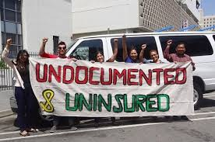
Undocu-CARE-Van
Fighting for health justice!
Inspired by the Undocubus
CAREvan traveled over 600 miles to create awareness and advocate for SB 1005
Made 5 regional stops: San Ysidro, Santa Ana, Los Angeles, Pomona, Fresno
Final stop in Sacramento on April 30th
In each stop there was a townhall, press event, or community talking circle

Slide 51
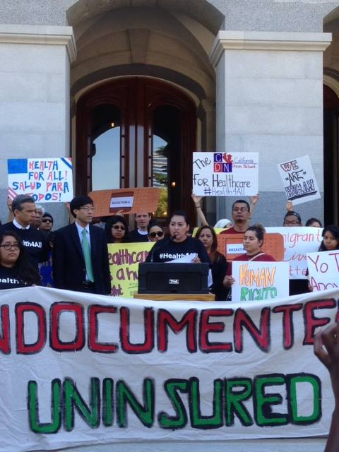
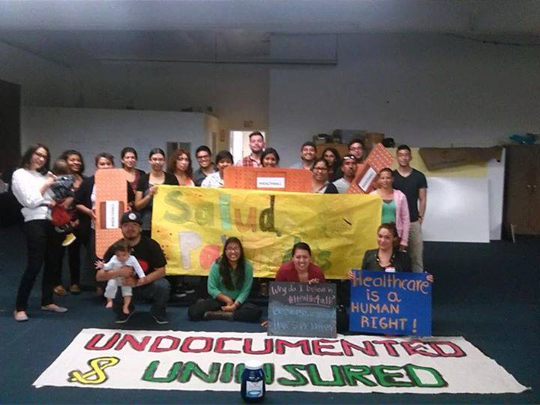
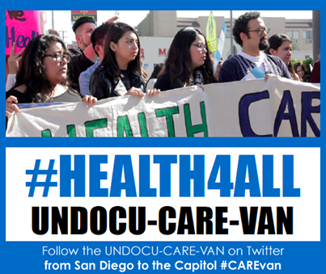
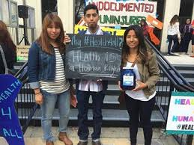
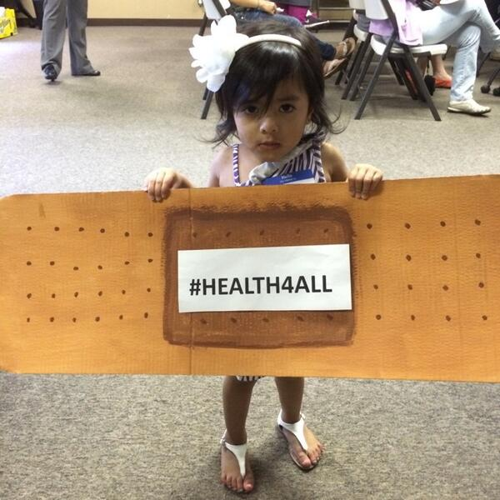
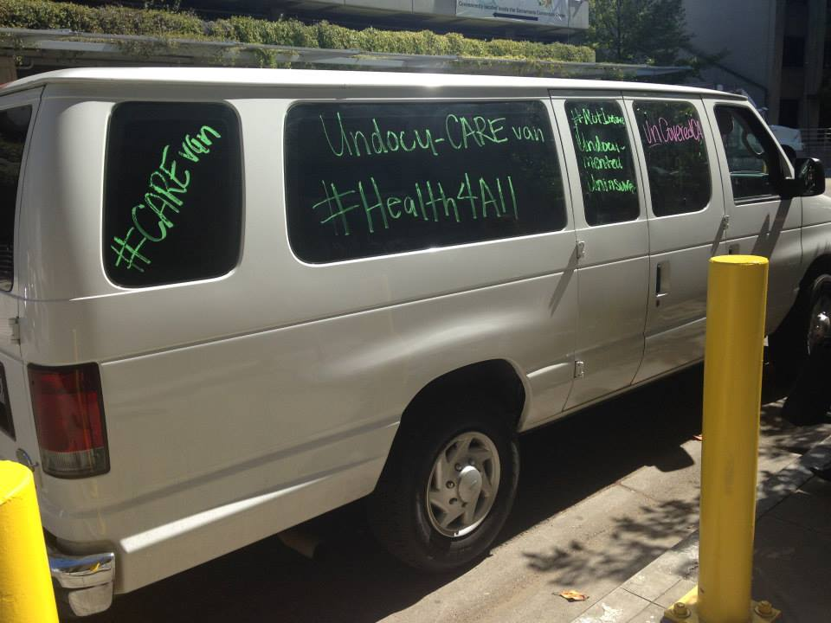
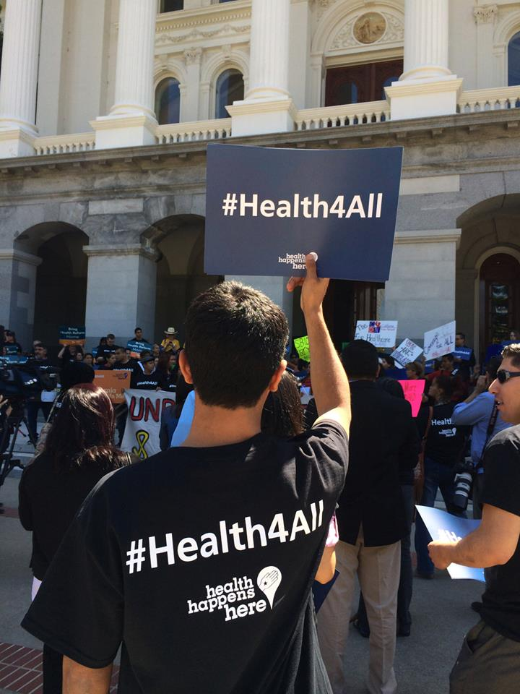
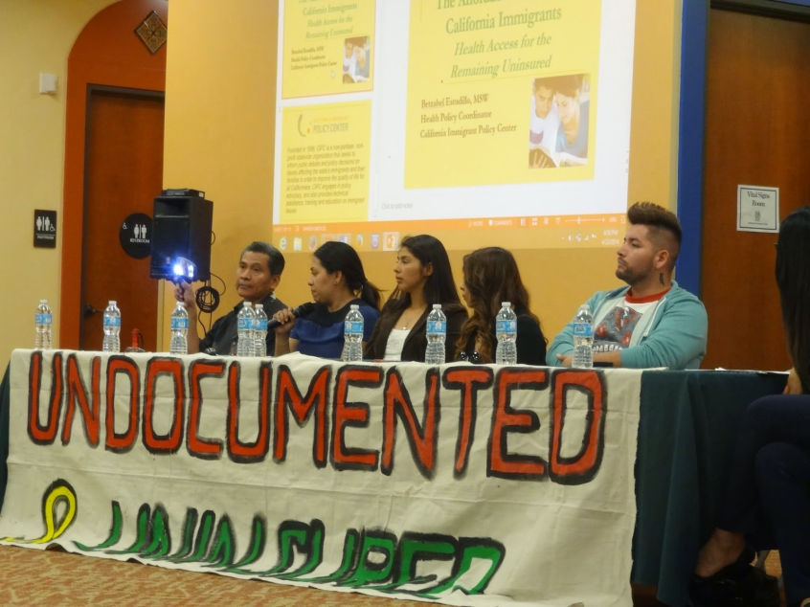
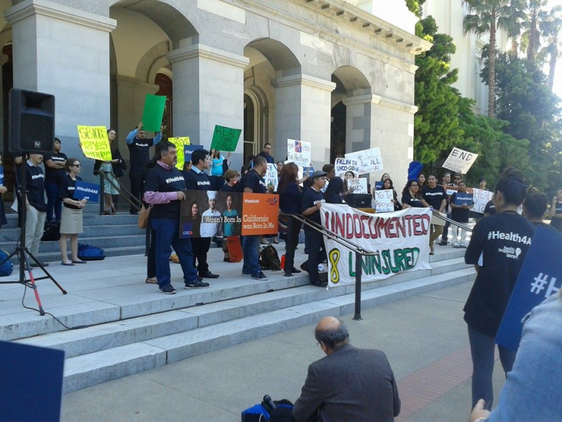

Slide 52
Where are we now?
Senate Health Committee Hearing on April 30th at 1:30pm
  Status: 5/1/14- Do Pass and re-refer to Appropriations Committee (6 Ayes-1 Noes)
  Next Hearing:
    Appropriations Committee
    Date: Monday, May 19th
Challenge: Fiscal impact, funding sources
Greater challenge: Not providing access to care to ALL Californians

Slide 53
How can I support?
What can I/my organization do to support?
  Get involved!
    Work with advocates
    Join community actions, town halls,
    Attend the hearing
    Share your story
    Share information in social media
      #Health4All #SB1005

Slide 54
For More Information
www.caimmigrant.org
www.undocumentedanduninsured.org
www.undocuhealth.blogspot.com

Slide 55

For Additional Information:
Betzabel Estudillo, Health Policy Coordinator, bestudillo@caimmigrant.org
Ronald Coleman, Government Affairs Manager, rcoleman@caimmigrant.org

Slide 56
Contact The Speakers
Kellen Russoniello, Staff Attorney – Health and Drug Policy, ACLU of San Diego & Imperial Counties krussoniello@aclusandiego.org
Gabrielle Lessard, Health Policy Attorney, National Immigration Law Center
Lessard@nilc.org
Betzabel Estudillo, Health Policy Coordinator, California Immigrant Policy Center
bestudillo@caimmigrant.org

