Slide 1

How to Navigate the State and County Welfare System
C
C
W
R
O
T
R
A
I
N
I
N
S
2023
Presenter: Kevin Aslanian
Phone: 916-712-0071
kevin.aslanian@ccwro.org
12/12/2023

Slide 2
The Federal Government Maze
CalWORKs – AFDC CalFresh-Food Stamps
TANF SNAP
HHS USDA
Office of Family Assistance FNS

Slide 3
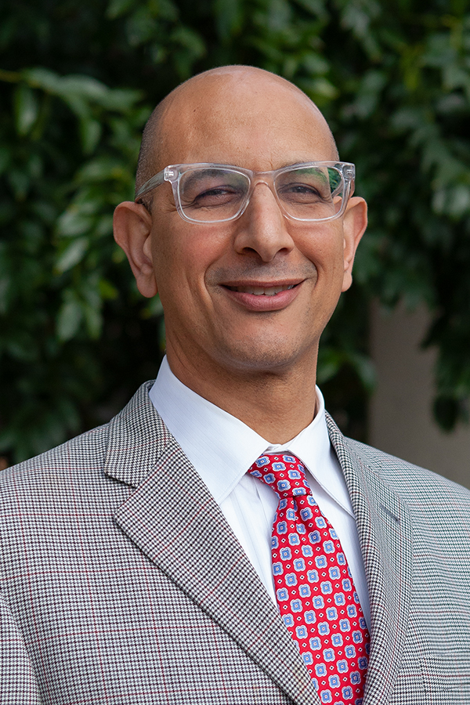
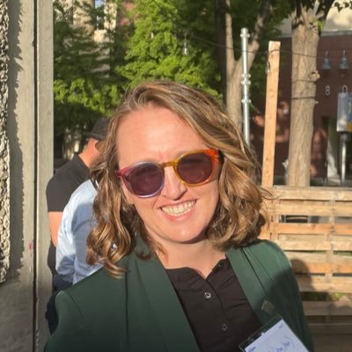
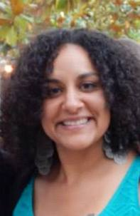
The State Government
Governor’s Office
California Health & Human Services Agency
Secretary- Mark Ghaly
CDSS Liaison – K.Jones
California Department of Social Services
Kim Johnson, Director

Slide 4
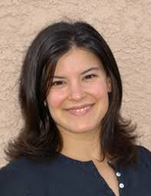

The State Government Cont.
CDSS Chief Deputy Director
Jennifer Troia
CDSS Deputy Director for Family Engagement & Empowerment Division
Alexis Fernandez-Garcia
CalWORKs WtW CalFresh
Lisa Witchey Damien Ladd Andrea Brayboy

Slide 5
The Legislative Branch
Assembly Human Services Committee - https://ahum.assembly.ca.gov/
Assembly Budget Committee, Sub #1 - https://abgt.assembly.ca.gov/sub-committees/sub-1-health-and-human-services
Senate Human Services Committee - https://shum.senate.ca.gov/
Senate Budget Committee, Sub # 3 - https://sbud.senate.ca.gov/subcommittee3
DOF - https://dof.ca.gov/
LAO - https://lao.ca.gov/

Slide 6
Public Benefits Regulations
Regulations – EAS Manual – https://www.cdss.ca.gov/inforesources/cdss-regulations-home-page
Adult Services Regulations (Social Service Standards Manual)
CalWORKs/CalFresh Regulations
Child Welfare Services Regulations
Confidentiality, Fraud, Civil Rights and State Hearings Regulations
Fiscal Management and Control Regulations

Slide 7
Public Benefits Regulations Cont.
Foster Care Regulations
Operations Manual
Refugee Program Regulations
Specialized Program Regulations
Staff Development and Training Manual
Statistical Reports Regulations

Slide 8
Welfare Policy Sources
Statute- Welfare & Institutions Code - https://leginfo.legislature.ca.gov/faces/codes_displayexpandedbranch.xhtml?tocCode=WIC&division=9.&title=&part=&chapter=&article=
Regulations – EAS Manual – https://www.cdss.ca.gov/inforesources/cdss-regulations-home-page
ACL - https://www.cdss.ca.gov/inforesources/letters-regulations/letters-and-notices/all-county-letters

Slide 9
Welfare Policy Sources
ACIN - https://www.cdss.ca.gov/inforesources/letters-regulations/letters-and-notices/all-county-information-notices
ACWDL- https://www.cdss.ca.gov/inforesources/letters-regulations/letters-and-notices/county-letters
Fiscal Letter - https://www.cdss.ca.gov/inforesources/letters-regulations/letters-and-notices/county-fiscal-letters
County Single Allocation Reports - CCWRO

Slide 10
Welfare Policy Sources
ccwro.org – Agency Contacts
County Welfare Office & More
CDSS Telephone Rosters & More
Dept. of Health Care Services
ccwro.org – Advocate Resources
Advocate Resources Public Assistance Table
Welfare Advocate Forms
Welfare Program Information Links
Helpful Advocate Links
Historical Public Benefits Studies and Reports
Welfare Beneficiary State Hearing Information
CalWORKS Annual State Reports
Proposed State Regulations

Slide 11
22-23 CalWORKs Single Allocation Expenditures
CalWORKs | ALLOCATION | EXPENDITURES | DIFFERENCE | % SPENT | CFL #
Expanded Subsidized Employment (ESE) | $134,145 | $90,584 | $43,561 | 67.53% | CFL 22/23-02 & CFL 22/23-78
Family Stabilization (FS) | $51,597 | $60,504 | ($8,907) | 117.26% | CFL 22/23-18
Home Visiting Program | $99,521 | $58,318 | $41,203 | 58.60% | CFL 22/23-12
Housing Support Program (HSP) 2 | $436,678 | $168,991 | $267,687 | 38.70% | CFL 22-23-43
Mental Health & Substance Abuse |  |  |  |  | CFL 22/23-17
Mental Health | $76,292 | $68,394 | $7,898 | 89.65%
Substance Abuse | $50,314 | $20,580 | $29,734 | 40.90%
Total | $126,606 | $88,974 | $37,632 | 70.28%
CalWORKs Single Allocation |  |  |  |  | CFL 22/23-18E
CalLearn | $16,258 | $10,893 | $5,365 | 67.00% | CFL 22/23-85
Eligibility Admin | $659,135 | $751,429 | ($92,294) | 114.00%
Employment Services | $1,109,422 | $809,928 | $299,494 | 73.00%
TOTAL SINGLE ALLOCATION | $1,784,815 | $1,572,250 | $212,565 | 88.09%

Slide 12
22-23 Employment Single Allocation Expenditures
COUNTY | ALLOCATION | EXPENDITURES | NOT SPENT
ALAMEDA | $37,406,964 | $26,942,427 | $10,464,537
BUTTE | $7,475,230 | $4,801,659 | $2,673,571
CONTRA COSTA | $26,599,158 | $15,601,202 | $10,997,956
FRESNO | $41,508,957 | $34,541,323 | $6,967,634
IMPERIAL | $12,419,104 | $5,788,633 | $6,630,471
KERN | $38,008,787 | $27,978,280 | $10,030,507
LOS ANGELES | $324,402,768 | $238,396,173 | $86,006,595
MADERA | $4,070,056 | $3,575,805 | $494,251
MERCED | $15,264,299 | $8,603,791 | $6,660,508
MONTEREY | $13,906,913 | $10,240,543 | $3,666,370
ORANGE | $51,284,188 | $34,486,163 | $16,798,025
RIVERSIDE | $53,210,379 | $44,518,908 | $8,691,471
SACRAMENTO | $78,431,823 | $38,104,174 | $40,327,649
SAN BERNARDINO | $76,868,669 | $56,714,292 | $20,154,377
SAN DIEGO | $62,944,506 | $41,385,008 | $21,559,498
SAN FRANCISCO | $24,079,875 | $18,928,447 | $5,151,428
SAN JOAQUIN | $19,381,370 | $11,020,007 | $8,361,363
SAN LUIS OBISPO | $5,827,888 | $3,679,792 | $2,148,096
SAN MATEO | $8,393,382 | $5,719,824 | $2,673,558
SANTA BARBARA | $8,709,933 | $7,264,794 | $1,445,139
SANTA CLARA | $44,394,993 | $43,049,806 | $1,345,187
SOLANO | $8,850,657 | $8,402,373 | $448,284
SONOMA | $9,479,818 | $8,765,271 | $714,547
STANISLAUS | $21,711,675 | $13,160,105 | $8,551,570
TULARE | $16,803,907 | $10,392,988 | $6,410,919
VENTURA | $15,668,705 | $12,066,609 | $3,602,096
TOTAL | $1,109,421,800 | $809,927,558 | $304,424,728

Slide 13
The County Bureaucracy
Board of Supervisors – Public Comment
CWD Budget Hearings – PRA for CWD budget proposal to the Board and adopted budget
Office if the County Executive
County Exec.’s office contact person for the CWD

Slide 14
The County Bureaucracy
County Welfare Director
Deputy Director
Program Specialist

Slide 15
The County Bureaucracy
District Director
Divisions with the CWD
Get a copy of the CWD rosters - PRA

Slide 16
The County Bureaucracy
Worker – EW
EW Supervisor
WtW social worker
WtW supervisor

Slide 17
The County Bureaucracy
County Training Bureau
SIU – County or DA
How SIU runs the eligibility illegally
IEVS Unit – 90 days processing

Slide 18
The County Bureaucracy
Appeals Representative
Appeals Supervisor
Where are appeals located
  ACMS https://acms.dss.ca.gov/acms/login.request.do

Slide 19
PRA action
The County Bureaucracy
County Memos
County Procedures
County Policy Handbooks
County Forms –
County Statistical Reports about GA, etc.
County Staff Training Materials
Contact the local EW union office. Find out how do workers find out about change in policy

Slide 20
Meet with the County
Gather up some issues and proposed solutions if possible
Get other community partners to join you
Reach out to the County Welfare Director suggest a meeting to discuss these issues. Send an email to the Director.

Slide 21
Meet with the County
How to develop issues:
Issues that the folks you help are facing
Look at the data report of your county. https://www.cdss.ca.gov/inforesources/research-and-data

Slide 22
Meet with the County
What happens of the Director refuses to meet with you?
Contact your local board of supervisor and meet with her/his staff about these issues.

Slide 23
Meet with the County
What do you do when that does not work?
Make a public comment to the Board of supervisors
Collect and record the experiences of clients dealing with pernicious County actions.

Slide 24
The end
QUESTIONS

Slide 25
Thank you for attending How to Navigate the State and County Welfare System

