Slide 1

Understanding CalWORKs and CalFresh Overpayments
In Home Supportive Services (IHSS) For Children
Presented by
Grace Galligher, Directing Attorney and
Daphne Macklin, Researcher
Coalition of California Welfare Rights Organizations
Phone 916-736-0616
ccwro.org

Slide 2

Welcome
In Home Supportive Services (IHSS) For Children: A Medi-Cal Benefit For Minor Children With Disabilities

Slide 3

Goals of the Training
Provide advocates for IHSS eligible children with clear and practical information about
Eligibility requirements for IHSS for children.
The types of services that IHSS may provide.
The IHSS application and assessment process.

Slide 4
Basic eligibility
1 – The child lives in California
2 - The child receives Medi-Cal services.
Provides in-home assistance to minor children living in a low-income family that allows the child remain safely in the child’s own home.
3 – The child must be eligible for federal Social Security Supplemental Security (SSI or Title XVI) benefits.

Slide 5
IHSS AND Medi-Cal
When Child IHSS applicants are Medi-Cal eligible, the County determines eligibility using CDSS All County Letters (ACL) 14-67 and 12-36.
If the child is not Medi-Cal eligible then the county must review eligibility under IHSS R (ACL 22-44 and All County Information Notice (ACIN) 1-08-18)

Slide 6
SSI and Medi-Cal
IHSS services for minors generally use the rules that apply to adults with certain exceptions.
IHSS funding are authorized for activities that the child cannot perform because of a disability, not because of the child’s age. (WIC §12300(a))
Age Appropriate Guidelines and the existence of extraordinary need is used to establish a minor’s IHSS services. ( See ACIN 1-82-17, page 5)

Slide 7
Determining child disability
The Federal Social Security Administration (SSA) determines a child’s medical disabilities using age - appropriate guidelines.
Specifically, an SSI-eligible child is:
not married (as determined by Social Security)
Not a head of a household and Is under age 18; or
Is under age 22 and is a student regularly attending school (as determined by the federal Social Security Administration); and
to be eligible for SSI benefits (actual cash payments) a child must be either blind or disabled.
The impairments for children are listed here:
https://www.ssa.gov/disability/professionals/bluebook/ChildhoodListings.htm
See also https://www.ssa.gov/pubs/EN-05-10026.pdf

Slide 8
Assessing A Minor’s Need For Services
The basic rule is that if it is “usual” for a child of that age to safely perform a task, but the disabled minor is unable to do so safely, then the county must assess the child as an adult.
If the task is not normal for the disabled child to perform, then assess the child’s need as extraordinary need.
Extraordinary need exists if performing a task for a disabled minor takes longer than for a non-disabled child of the same age or consistently requires adult supervision or actual assistance.

Slide 9
County Eligibility and Hours of Service Assessment
Counties must evaluate service needs based on these factors:
Medically assessed disability
SSI eligibility
Appropriate hours of service based on:
IHSS Rankings
Types of IHSS services the child requires
Adjustments based on age, household compositions, residual functional capacity

Slide 10
Available Age Guidelines
County assessments may use Available Age Guidelines
  Age-Appropriate Guideline Tool From CDSS https://www.cdss.ca.gov/inforesources/ihss/training-academy
  CDC Developmental Guide https://www.cdc.gov/ncbddd/actearly/milestones/index.html

Slide 11
Authorized IHSS Personal Care Service
EXAMPLES:
assistance with ambulation
bathing, grooming, oral hygiene and skin care
dressing appropriately
care and assistance with prosthetic devices
bowel, bladder and menstrual care
physical repositioning, range of motion exercises and physical transfers
feeding and assurance of adequate fluid intake
assistance with self-administration of medications.

Slide 12
Rankings
Rankings are based on the recipient’s functional ability. (MPP 30-756.1, 30-763.2 and .3; ACIN I-82-17,ACIN I-97-20)
Hourly Task Guidelines use a “normal range of time” for certain services. (ACL 08-18; ACIN 1-82-17)
Rank 1 - Does not need help. Can do the task without any assistance.
Rank 2 - Able to do the task but needs verbal assistance.
Rank 3 - Able to do task with assistance.

Slide 13
Rankings cont.
Rank 4 - Able to do task with substantial assistance.
Rank 5 - Can’t perform task without human assistance.
Exceptions to HTG only when necessary to allow beneficiary to remain in home. (MPP § 30-757.1(a)(3); ACL 08-18, Q.3; ACIN I-82-17)
PRACTICE POINTER: Get a copy of the state and county rankings before the assessment appointment, over a few weeks keep an activity and time record of how long it takes to complete these tasks.

Slide 14
Assessment
County makes an appointment for home visit to identify and assess needed services.
Assesses living situation and layout
Number of cohabitants and number of rooms
Medical records including treatment and medical reports

Slide 15
Assessment Cont.
PRACTICE POINTER: Never downplay or minimize the work needed to care for the child, the parent must advocate for their hours. Show the worker around the home, especially the trouble spots.
Watch out for:
  Counties asking applicants to sign blank releases of information
  HIPPA releases
  Clients should provide the information, especially medical information
  Receive NOA approval/denial

Slide 16
Key IHSS Programs
CFCO– Individuals who are eligible for full-scope Medi-Cal.
  Medi-Cal qualified who otherwise need a nursing home level of care.
  Severely and non-severely disabled people can get up to 283 hours of services per month, including protective supervision.
  Most IHSS recipients are in this program. (ACL 14-60; WIC §14132.956)
PCSP- Individuals eligible for full-scope Medi-Cal. (WIC §14132.95)
  Medi-Cal eligible on basis of age, blindness or disability.
  Recipients who do not qualify for the IHSS-CFCO program are part of the Medi-Cal PCSP program.
  Severely and non-severely disabled people can get up to 283 hours of services per month, including protective supervision.

Slide 17
IHSS Programs cont.
IPO: Individuals who are eligible for full-scope Medi-Cal.
  IPO– Medi-Cal qualified and part of one of the following groups:
    Minor child beneficiaries who receive services from a parent provider.
    Beneficiaries who receive services from a spouse provider
    Advance pay cases or meal allowance cases.
The program provides a maximum of 195 to 283 hours of services per month, depending on the severity of the impairment. (WIC§14132.952)

Slide 18
IHSS Programs cont.
IHSS–R: Individuals who are NOT eligible for scope Medi-Cal. (ACIN I- 18-08)
  State Only Funding
  Do not meet PCSP or IPO requirements of having satisfactory Immigration Status.
  Non-severely impaired individuals can receive up to a maximum of 195 hours a month when receiving Protective Supervision. Severely impaired individuals receive 283 hours per month. (WIC§12303.4.)
  Has its own SOC that is different from the Medi-Cal share of cost It is the difference between income and the applicable SSI/SSP level. May have an IHSS share to cost.

Slide 19
Types of Services
Domestic Services
Related Services
Non-Medical Personal Services
Accompaniment
Protective Supervision
Paramedical Services
Time Limited Services

Slide 20
Domestic & Related Services
Domestic Services (per Month)
  Cleaning in rooms that the beneficiary uses
  General cleaning of refrigerator, stove, oven, counters, or sink
  Approved service hours are per month
Related Services (per Week)
  Meal Preparation – Guideline range 3.02 to 7.00 hours, (MPP 30-757.131)
  Meal cleanup -1.17 to 3.50 hours, (MPP 30-757.132)
  Routine Laundry -1 hour unless use laundromat 1.5 hours (MPP 30-757.134(a))
  Food Shopping -1 hour, (MPP 30-757.135)
  Other Shopping Errands- 0.5 hours per week (MPP 30-757.135(c))
  Approved service hours are per week

Slide 21
Proration of Services
Counties prorate hours for domestic services and related services
Proration is calculated by dividing the total number of hours IHSS service hours needed by the number of household members.
    Includes cleaning in common living areas
    Laundry
    Meal Preparation
Exceptions to Proration
    MPP 30-763.32 provides that meal preparation should not be prorated “when the service is being provided separately to the recipient.”
    Services not shared with other household members
    Certain household members not counted in proration

Slide 22
Non-Medical Personal Services
Non-Medical Personal Services (per Week)
Routine Bed Baths - 0.50 to 3.50 hours, (MPP 30-757.14(d))
Respiration Assistance- (MPP 30-757.14(b) ) No guideline range
  Setting up CPAP and cleaning CPAP and IPPB machines
Bowel, Bladder Care -0.58 to 8.00 hours, (MPP 30-757.14(a))
  Includes assistance with toileting and cleaning
Feeding - 0.70 to 9.33 hours, (MPP 30-757.14(c))
  Includes assistance to eat meals, including cleaning the face and hands before and after meals
Dressing - 0.56 to 3.50 hours, (MPP 30-757.14(f))
  Includes assistance with putting on and take off clothes as necessary throughout the day
Menstrual Care-0.28 to 0.80 hours, (MPP 30-757.14(j))
  Assistance with external placement of sanitary napkin and barrier pads

Slide 23
Non-Medical Personal Services Cont.
Ambulation-0.58 to 3.50 hours, (MPP 30-757.14(k))
  Assistance with walking or moving about the home, and into/out of car for transporting to medical appointment or alternative resources.
Repositioning and Rubbing Skin, Massage, Assistance with Prosthesis-0.75 to 2.80 hours, (MPP 30-757.14(g))
Transfer (Moving in/Out of Bed or On/Off Seats)-0.50-3.50 hours (MPP 30-757.14(h))
  Assist with change of position from standing, sitting or prone position
Bathing, Oral Hygiene, Grooming-0.50 to 5.10 hours (MPP 30-757.14(e))
  Assist with bathing or showering, teeth and hair care, shaving applying lotion, powder and deodorant

Slide 24
Paramedical Services
These services require authorization and training by a medical professional before the county will authorize services that are necessary to maintain health.
(MPP 30-757.191) See also 30-756.4; ACL 98-18 and ACIN 1-97-20.
Must be ordered by a licensed health care provider using the SOC 321
  Health Care provider determines the time needed to perform services
Time allocated on per Week basis
Paramedical services include:
  Administering medication
  Inserting a medical device into a body opening
  Wound care
  Treatments requiring sterile procedures
  Tube feeding
  Suctioning

Slide 25
Severely Impaired
Severely impaired if needs 20 or more services hours per week in one or more of these categories: non-medical personal care, paramedical services, meal preparation and, if the person requires assistance with eating, meal cleanup. (MPP 30-701(s)(1))
Eligible for a maximum of 283 hours per month.
If under IHSS-R or IPO eligible for 195 hours a month if the nonmedical personal services is less than 20 hours a week.

Slide 26
Nonself-Direction
Minor is not able to assess danger and risk of harm due to mental impairment or mental illness.
    Most likely to engage in dangerous activities that cause harm. (MPP 30-757.17 ACL 15-25)
Based on minor’s memory, orientation and judgment. (Welf.& Inst. Code § 12300 (e)(4)
  Memory: Ability to recall learned behaviors and information. (30-756.372; ACIN I-82-17)
  Orientation: Knows time, place, self, etc. (30-756.372; ACL 15-82; ACIN I-82-17)
  Judgment: Ability to make decisions that avoid danger and able to evaluate alternative actions. (ACIN I-82-17)

Slide 27
Protective Supervision (PS)
Protective Supervision (PS) is an IHSS services for people who are both nonself-directing and due to a mental impairment or mental illness, need to be observed 24 hours per day to protect from injuries, hazards or accidents. (MPP 30-757.17)
The “mental impairment” or “mental illness” must impair the judgment, memory or orientation, eg; Wanders off and gets lost; walks into traffic, turns on the stove and forgets to turn it off.
Not self-directing.
A SOC 821-Assessment of Need for Protective Supervision for In-Home Supportive Services needs must be completed by the doctor. Make sure the doctor says the person needs 24 hours a day PS.
Persons who need PS can get 195 hours a month or 283 hours a month.

Slide 28
Protective Supervision &
IHSS for Children
The measure for PS is the functional limitations of child compared to other children of the same age, which requires more care than the average unimpaired child of the same age. (WIC § 12300(d)(4); ACL 15-25)
Age is not a controlling factor in determining eligibility.
Get a doctor’s statement and do not allow the county to go fishing for information to make the child ineligible.
Parent can be child’s provider if, “The parent has left full-time employment or is prevented from obtaining full-time employment because no other suitable provider is available and the inability of the parent to perform supportive services may result in inappropriate placement or inadequate care.” (MPP 30-763.451)

Slide 29
Ineligibility for Protective Supervision
Anti-social or aggressive child behavior (30-172(d); ACL 17-95)
Deliberate self-destructive behavior, e.g., suicide. (30-172(e); ACL 17-95)
Routine Child Care (Welf. & (Inst. §12300(e)(4); ACL 15-25)

Slide 30
Minor Medical Accompaniment
Payment for accompaniment to Appointments (MPP 30-757.15)
Counties will authorize a provider to be paid to transport the IHSS beneficiary.
Minor must have an assessed extraordinary need.
Appointment must be with a specialist and relate to disability and functional impairment, not routine care.
IHSS tasks needed to be performed to attend medical appointment. See ACL 17-42

Slide 31
Minor Medical Accompaniment Cont.
Wait time - Fair Labor Standards Act
    FLSA regulations 29 CFR 785.15 and 785.16 define two different types of wait time
    “Engaged to wait” The provider will be paid to accompany the recipient to a medical appointment of unknown duration and the provider is required to remain at the doctor's office because at any moment he/she may be called upon to assist the recipient with returning home.
    “Waiting to be engaged” The provider will NOT be paid to accompany the recipient to appointments since the wait periods of time are long enough to enable the provider to the time effectively for his own purposes.

Slide 32
Receipt of IHSS Services
Upon approval, the county identifies authorized services and the number of hours per month
Recipient must:
  Must find a provider
  County may have contracted providers
  County may have homemaker employees
  Must train, supervise and fire provider

Slide 33
Purpose of Reassessment
Determine level of services needed to avoid being placed in out of home care. (MPP 30-761.13, .14 and .25)
Face to Face Assessment conducted by county worker. (MPP 30-761.13 and 30-761.3 )

Slide 34
Reassessment Timing
General Rule: Counties reassess every 12 months. (MPP §30-761.212)
  County may extend reassessment to 18 months if the recipient has stable circumstances (MPP 30-761.215(a)-(h) through 30-761.217)
  Counties may shorten to less than 12 months. (MPP 30-761218)
  County may request a SOC 821 (ASSESSMENT FOR PS) OR A SOC 321(Request for Order and Consent-paramedical services).

Slide 35
Reassessment Timing Cont.
Pursuant to (MPP§30-761.219(a)(b) and §30-761.218) reassess the recipient’s need for services:
  (a) Any time the recipient notifies the county of a need to adjust the service hours authorized due to a change in circumstances.
  (b) When there is other pertinent information, which indicates a change in circumstances affecting the recipient’s need for supportive services.
  Change includes functional needs, living arrangement or severity of condition or disability.
IHSS hours cannot be changed:
  without an assessment and
  Reduced at assessment unless there is a change (MPP § 30-761.28)

Slide 36
Thank you for attending
Questions?

Slide 37
In Home Supportive Services (IHSS) For Children
Appendix
IHSS NOA Examples
Hourly Task Guidelines (created by CDSS and Sac State)
Age - Appropriate Guideline Tool for Minor Children
Legal Authorities Governing the IHSS Program

Slide 38
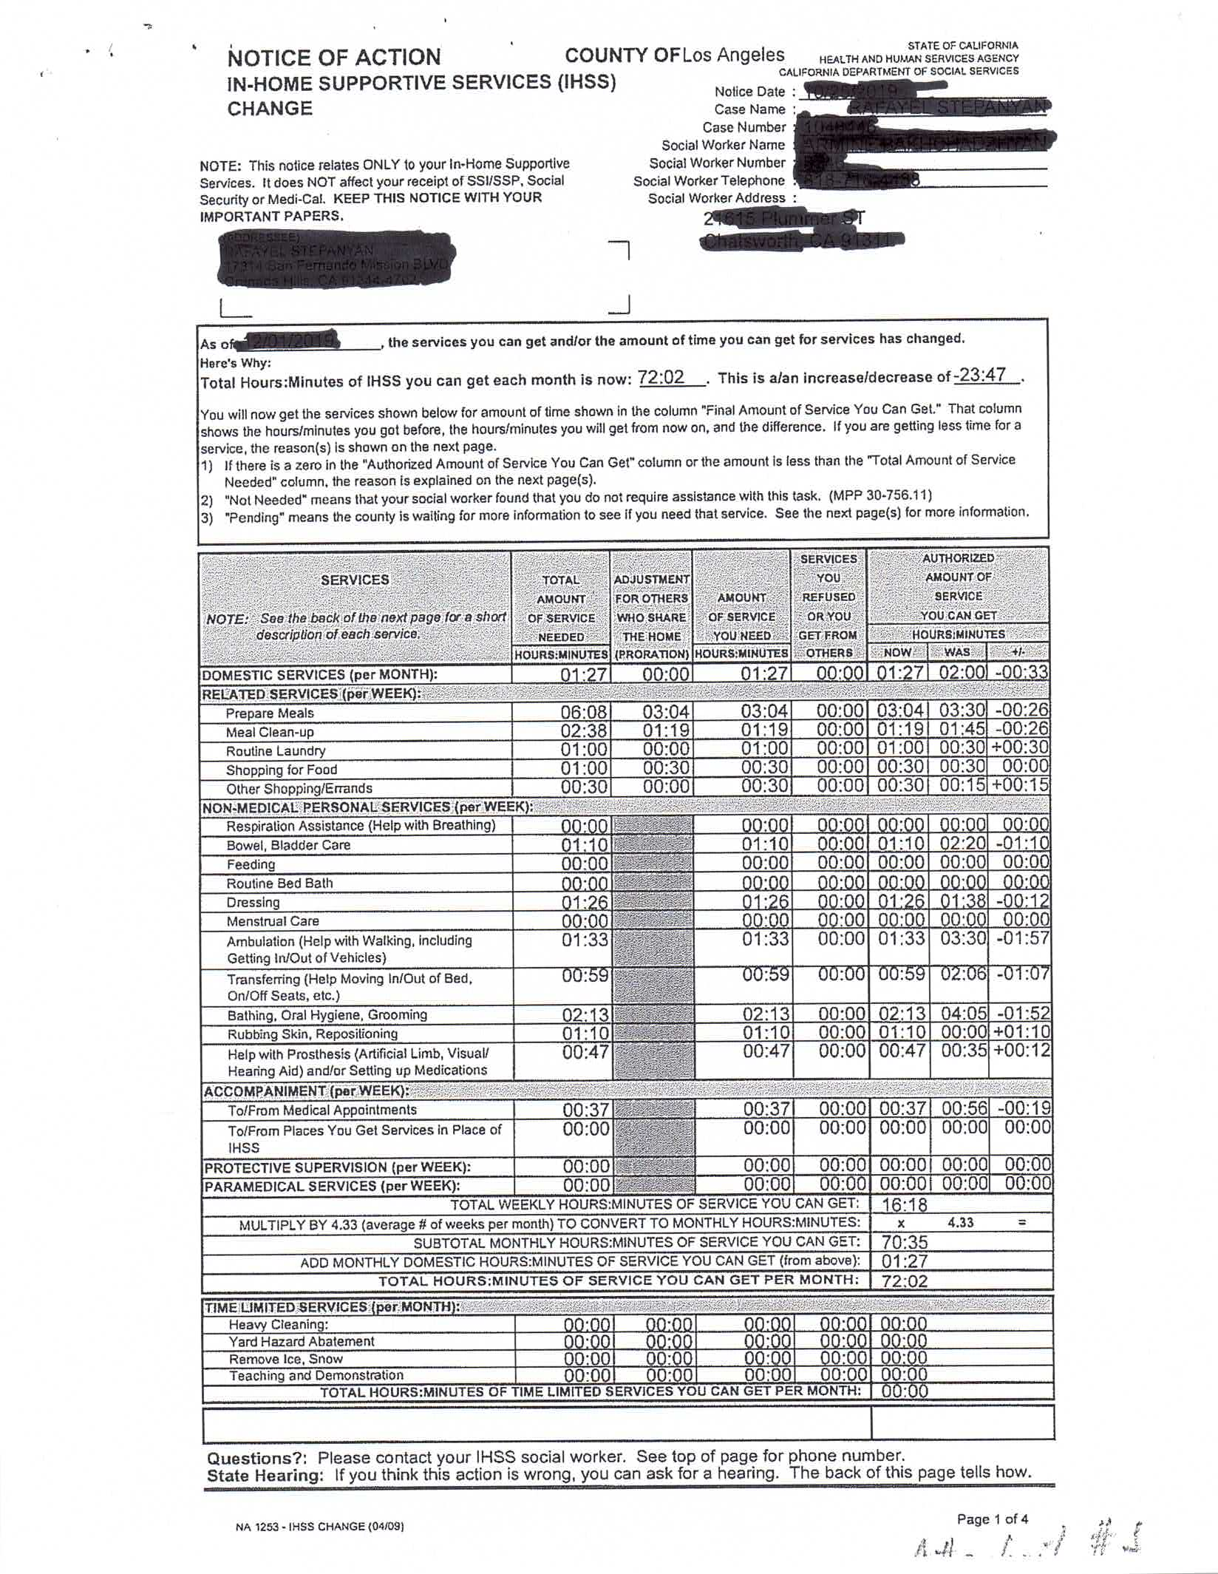

Slide 39
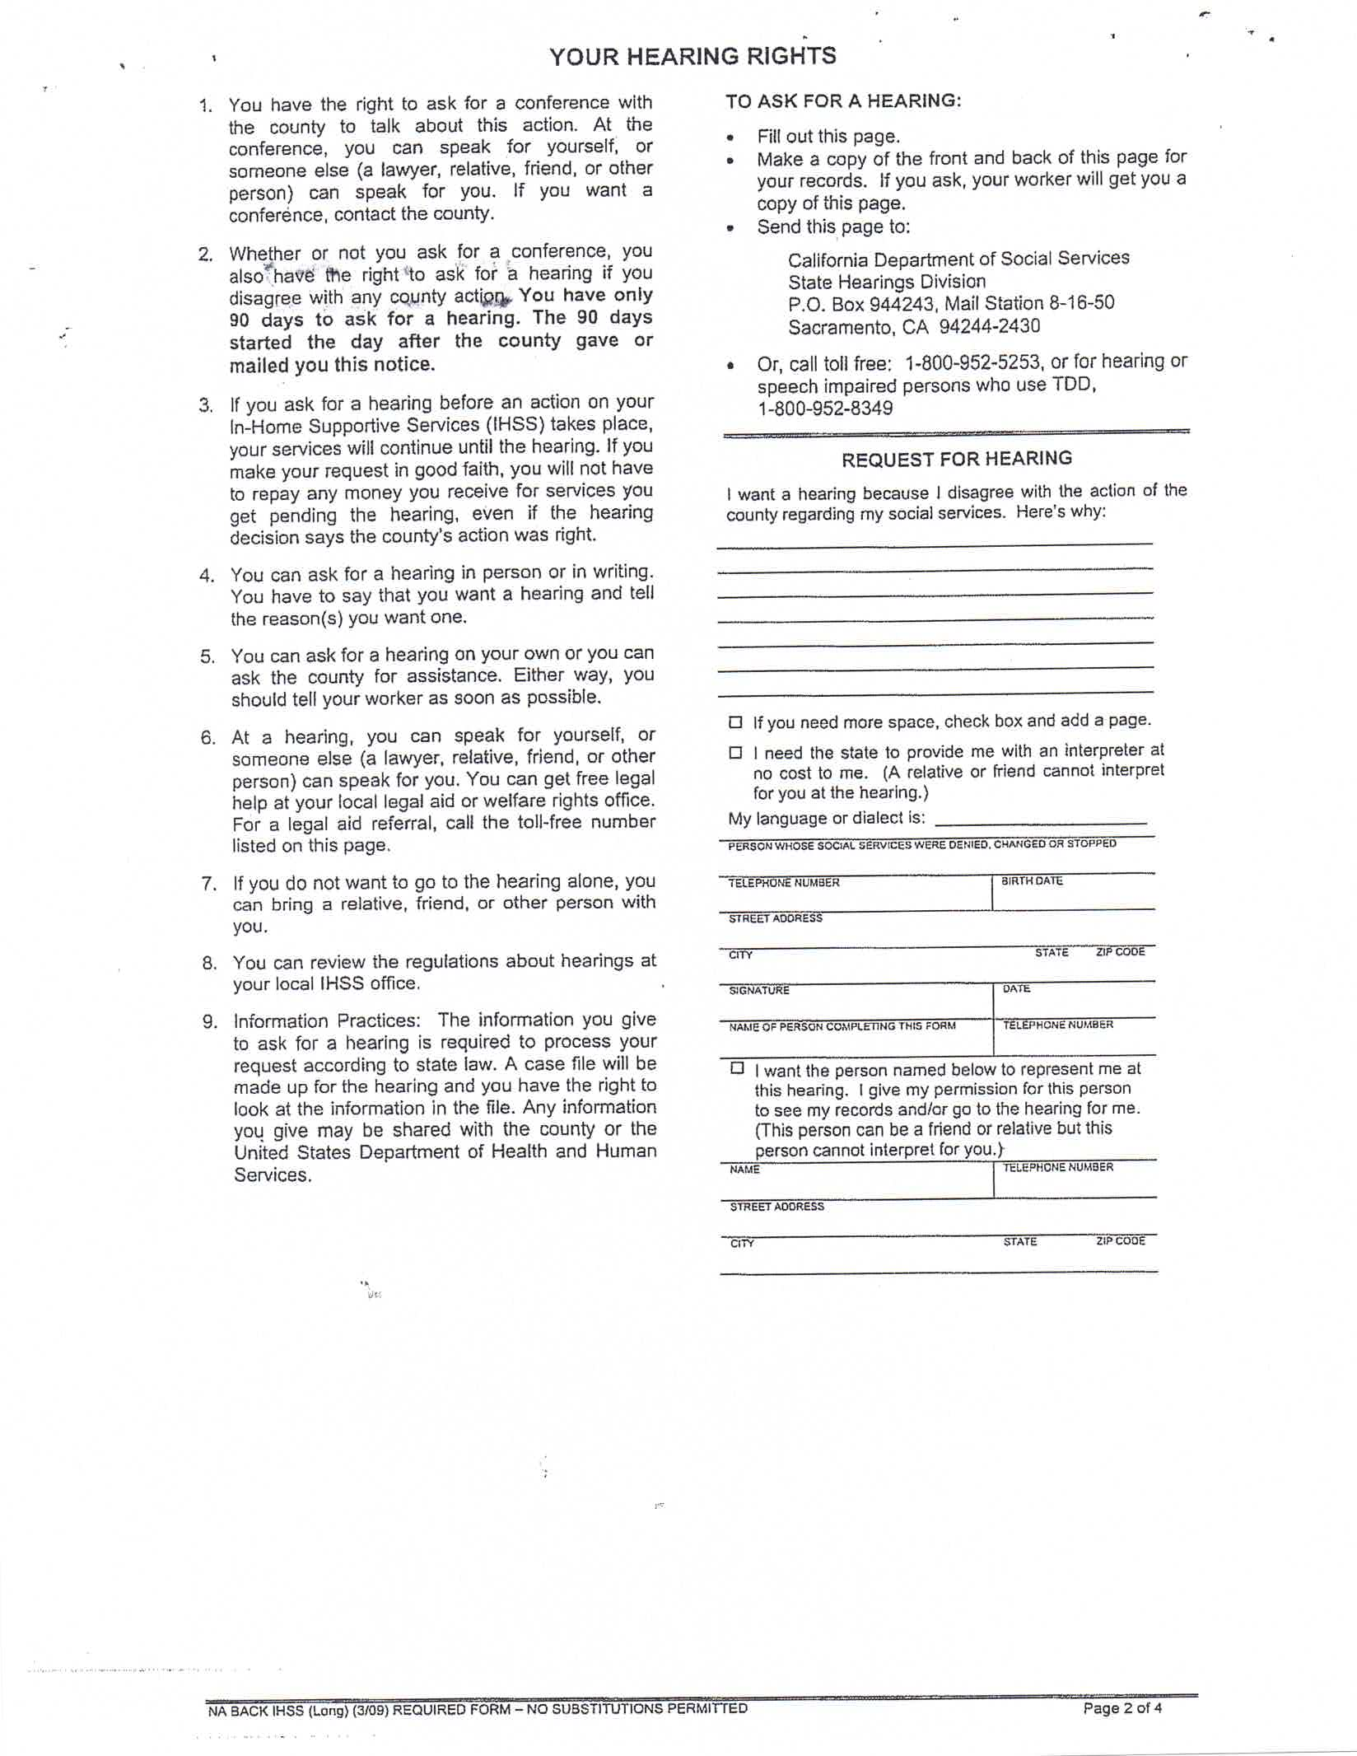

Slide 40
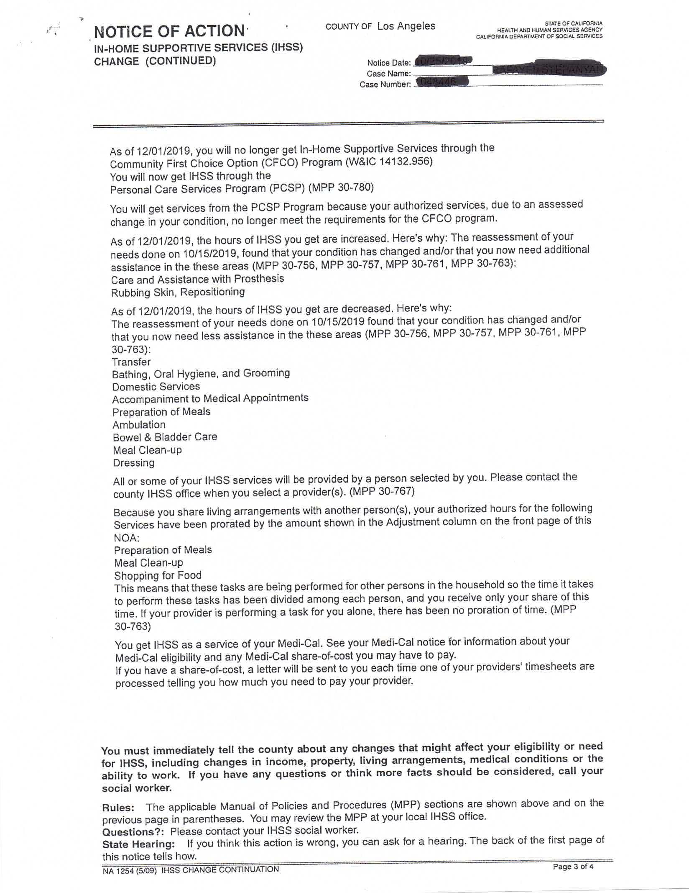

Slide 41
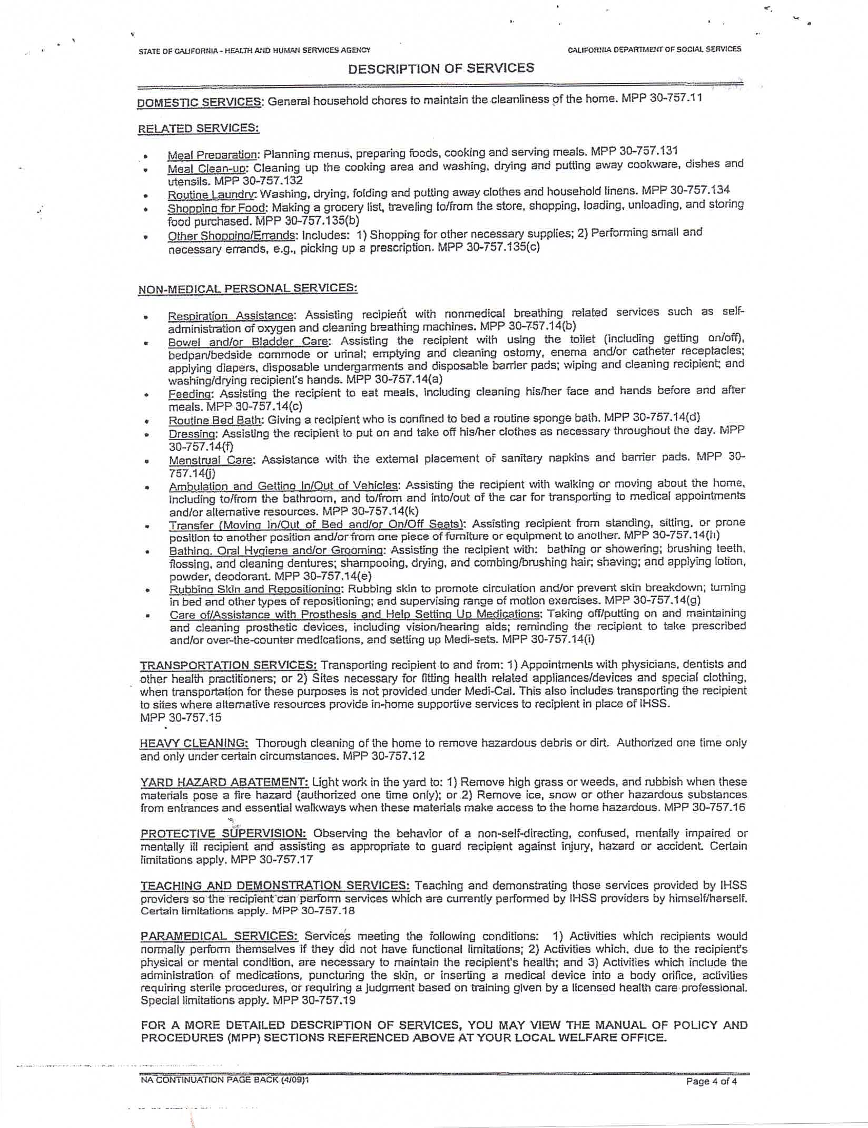

Slide 42
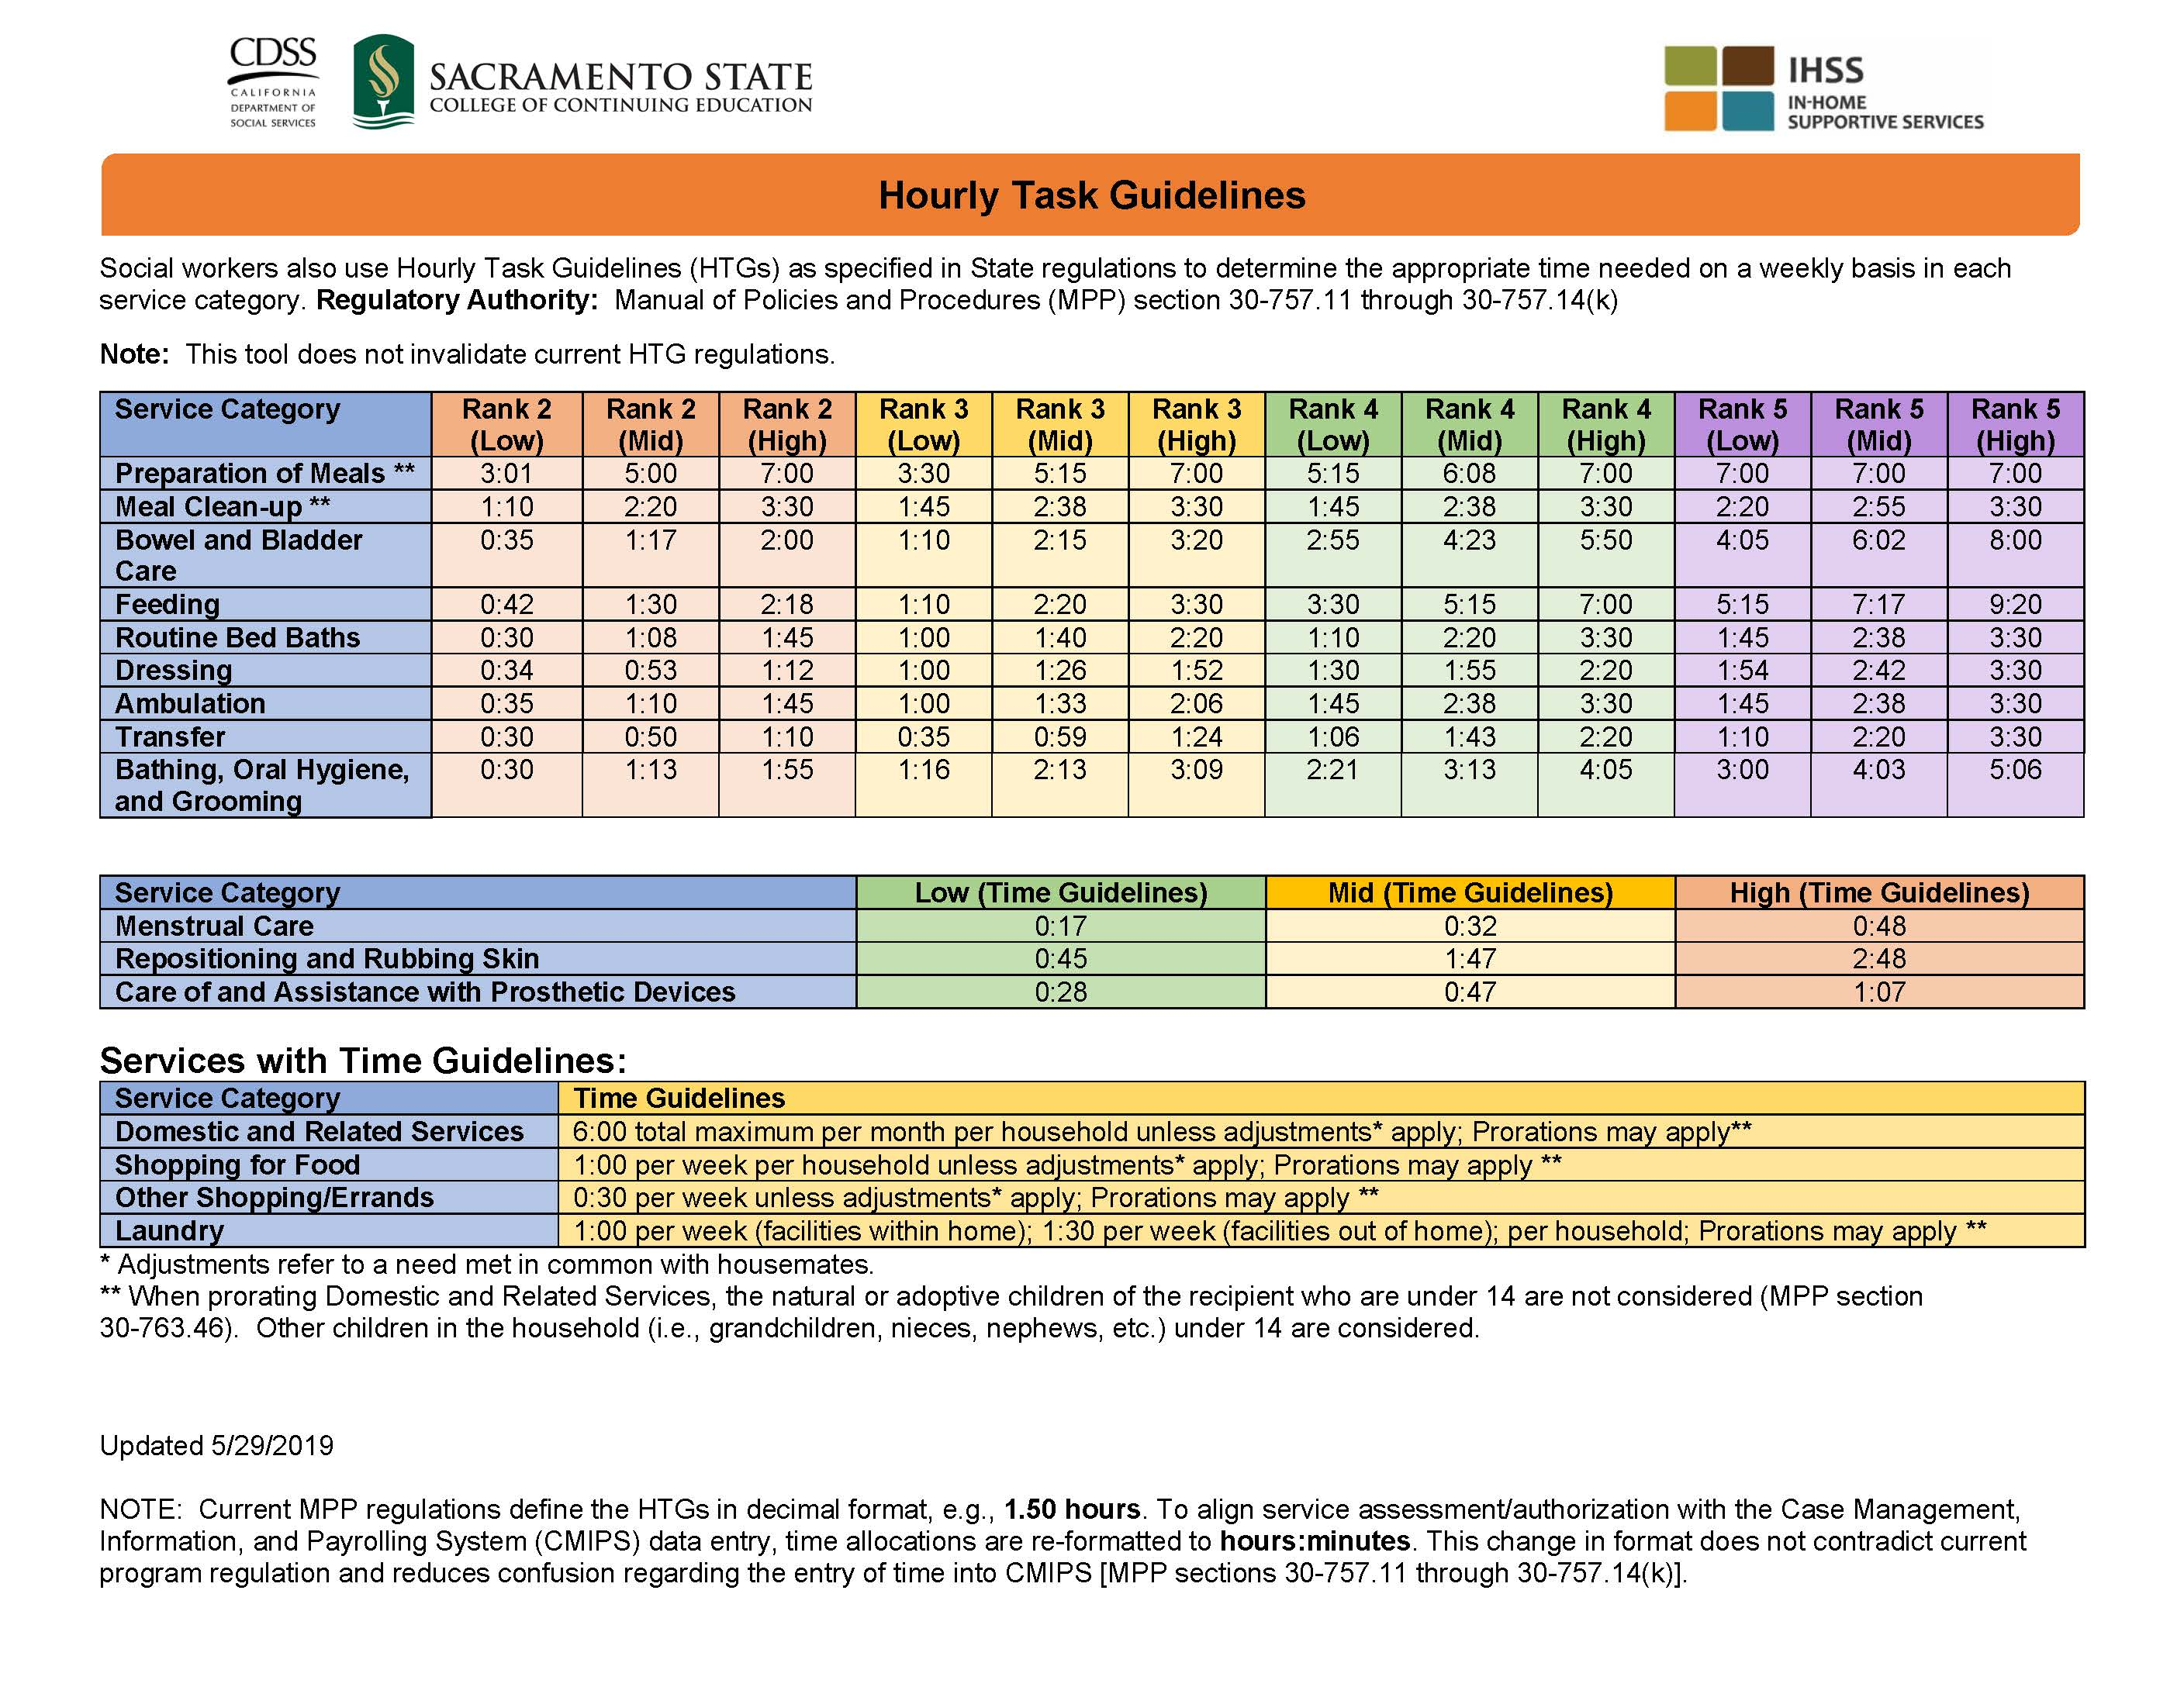

Slide 43
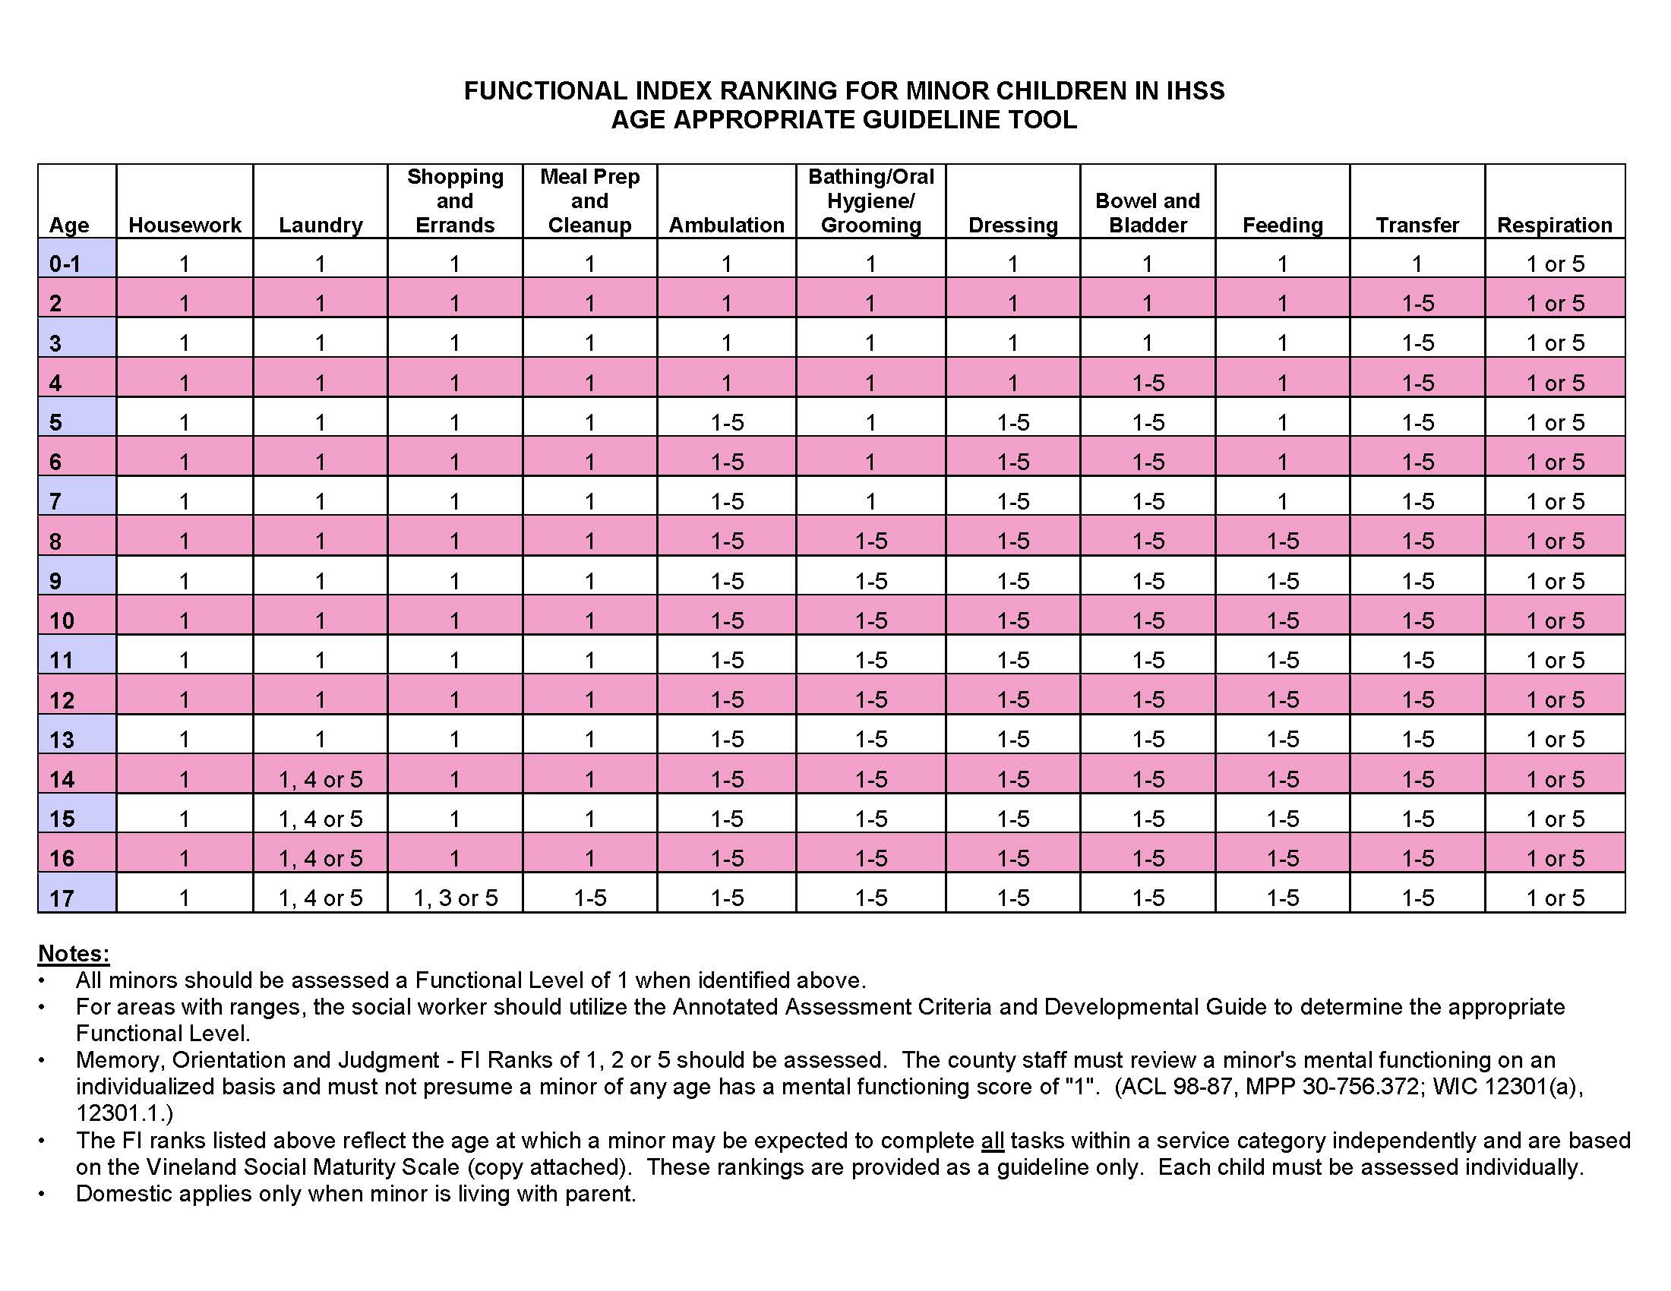

Slide 44
Legal Authorities Governing the IHSS Program
General Services- WIC §12300 et. seq.
Community First Choice Option (CFCO) – (42 CFR 441 subpart K; WIC §14132.956)
Personal Care Services Program (PCSP) – (WIC§14132.95; 22 CCR Div 3)
IHSS Plus Option (IPO) - (WIC §14132.95; 22 CCR Div 3)
IHSS Residual (IHSS-R) - (WIC § 12300 through 12317.2)
California Code of Regulations, Title 22 § 50045.5 et. seq.
IHSS regulations – CDSS Manual of Policies and Procedures (MPP) 30-700 et. seq.

Slide 45
IHSS-R and IPO - 30-700 through 30-776
PSCP -MPP 30-780 et. seq.
Social Services Standards -MPP 30-000 et. seq.
All County Letters – http://www.dss.cahwnet.gov/lettersnotices/PG931.htm
All County Information Notices- http://www.dss.cahwnet.gov/lettersnotices/PG1011.htm
All County Welfare Director Letters- http://www.dhs.ca.gov

