Slide 1
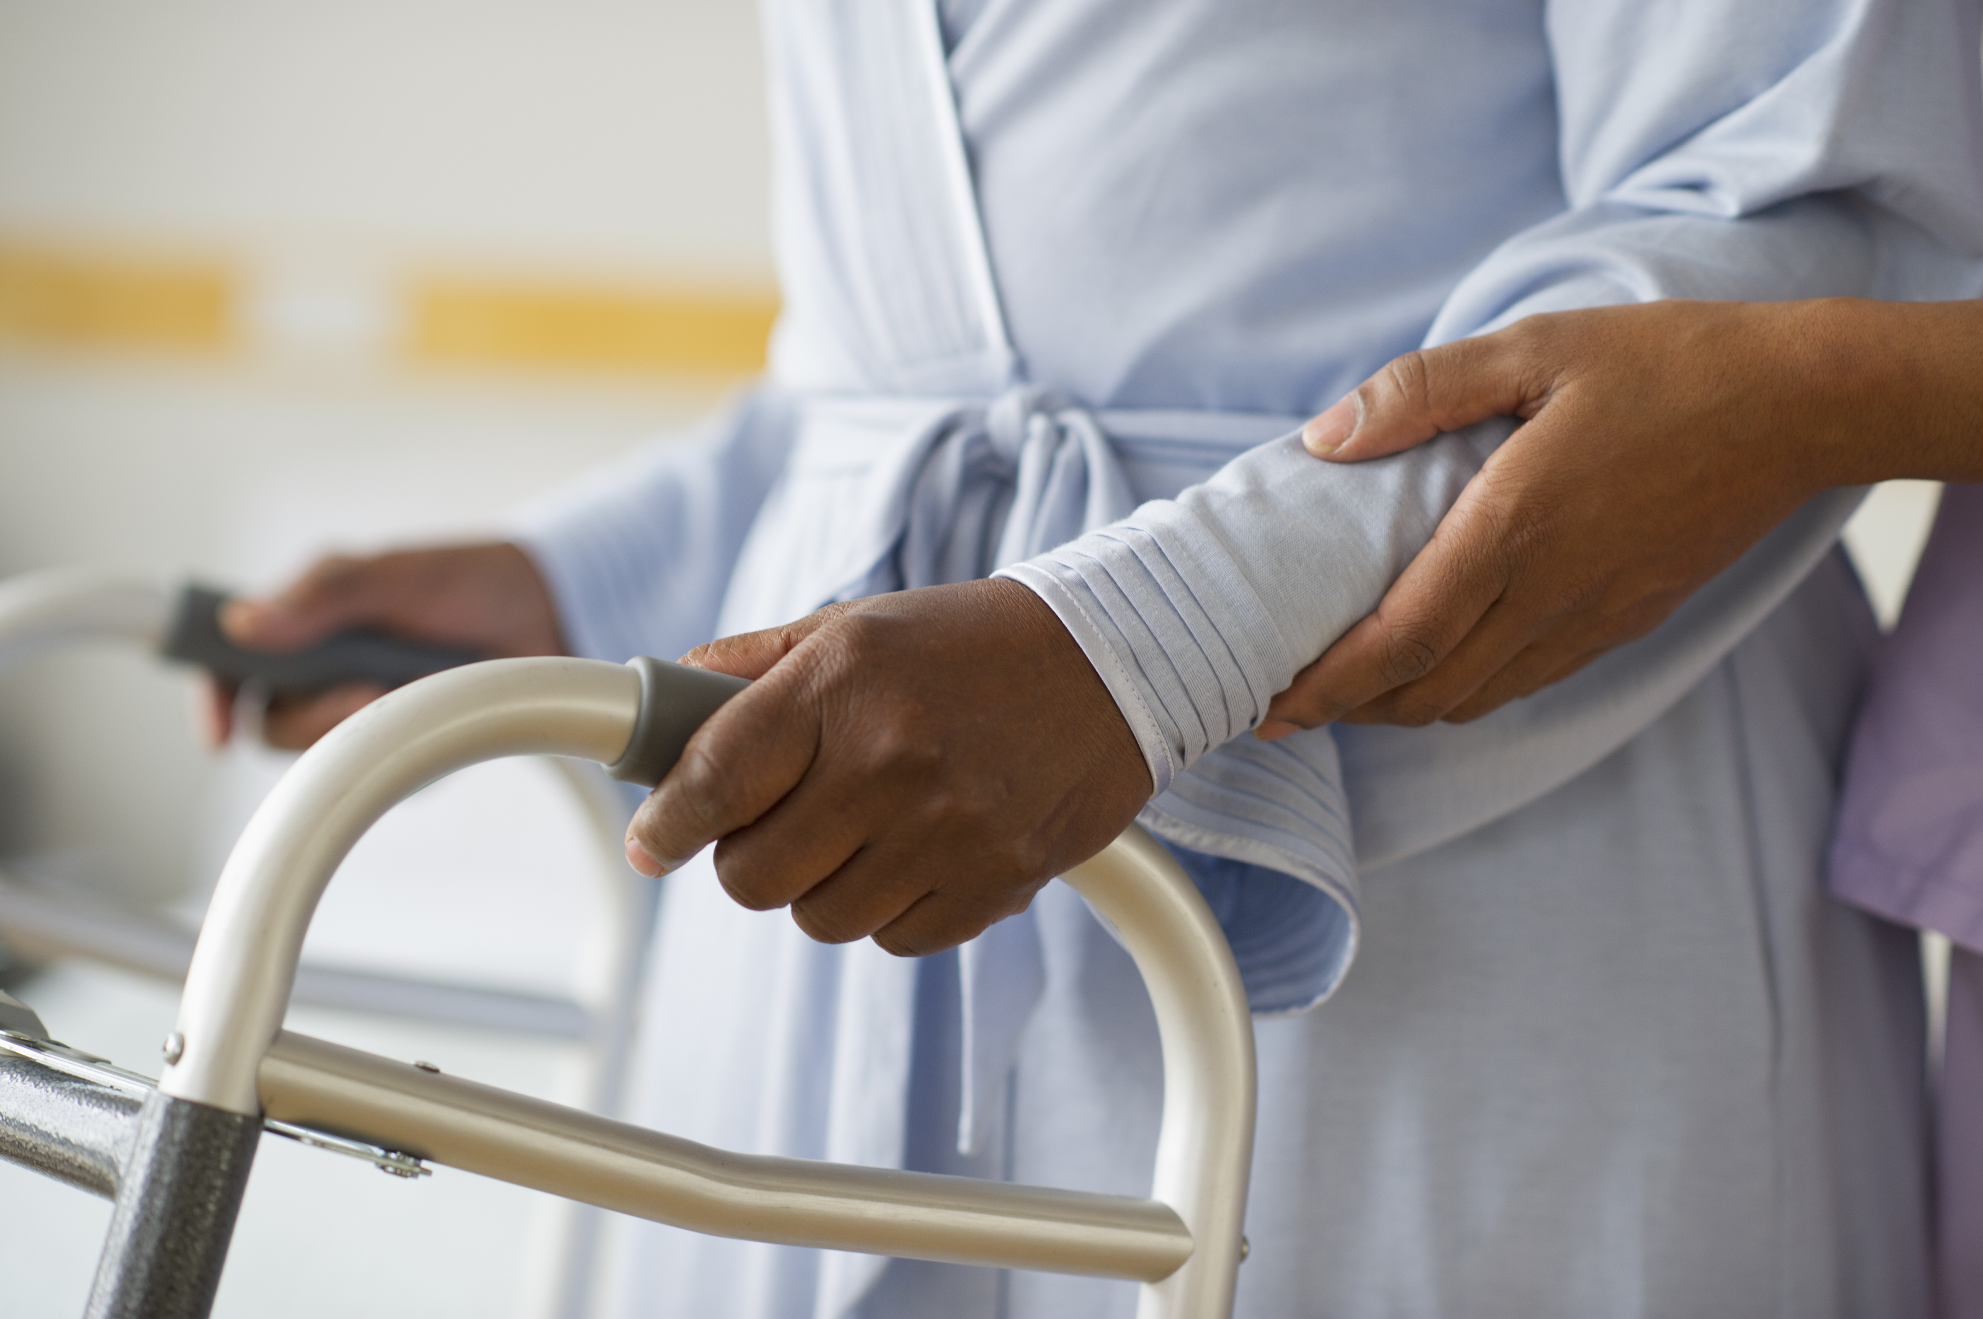

In Home Support Services Program
C
C
W
R
O
T
R
A
I
N
I
N
g
2023
ccwro.org
IHSS 101
12/14/2023
Presenters: Grace Galligher & Daphne Macklin
Coalition of California Welfare Rights Organizations

Slide 2
IHSS PROGRAM
Joint CDSS and CDHS program
Provides in-home assistance to eligible aged, blind and disabled individuals so that they can remain safely in their own homes.
Physically reside in US and State of California resident
SSI/SSP or Medi-Cal recipient
Live at home or abode of choosing
  Not acute care hospital long-term care facilities and licensed community care facilities

Slide 3
APPLICATION PROCESS
MPP 30-009.22 governs IHSS applications.
Application can be made by the applicant or any person on his or her behalf by phone, letter referral.
The application form CA 295 is only signed by the applicant during the face-to-face assessment for services.
Submit a Health Care Certification (SOC 873)
MPP 30-759.11 provides for 30 days to determine IHSS hours from the date that the CA 295 is signed.

Slide 4
ASSESSMENT
County makes an appointment for home visit to identify and assess needed services.
Assesses living situation and layout
  Number of cohabitants and number of rooms
Show the worker around the home, especially the trouble spots
County will need medical records including treatment and medical reports
Watch out for:
  Counties asking applicants to sign blank releases of information;
  HIPPA releases.
  Clients should provide the information, especially medical information.
  Receive NOA approve/denial IHSS

Slide 5
PRORATION of SERVICES
Counties prorate hours for domestic services and related services
Proration is calculated by dividing the total number of hours IHSS service hours needed by the number of household members.
    Includes cleaning in common living areas
    Laundry
    Meal Preparation
Exceptions to Proration
    MPP 30-763.32 provides that meal preparation should not be prorated “when the service is being provided separately to the recipient.”
    Services not shared with other household members
    Certain household members not counted in proration

Slide 6
RANKINGS
Beneficiaries should be ranked based on the recipient’s functional ability. MPP 30-756.1
Rank 1 - Does not need help. Can do the task without any assistance.
Rank 2 - Able to do the task but needs verbal assistance.
Rank 3 - Able to do task with assistance.
Rank 4 - Able to do task with substantial assistance.
Rank 5 - Can’t perform task without human assistance.
PRACTICE POINTER: Get a copy of the county rankings before assessment and over a few weeks keep activity and time record of how long it takes to complete tasks.

Slide 7
STATUTORY PROVISIONS
General Services- WIC §12300 et. seq.
Community First Choice Option (CFCO) - 42 CFR 441 subpart K; WIC §14132.956
Personal Care Services Program (PCSP) - WIC§14132.95; 22 CCR Div 3
IHSS Plus Option (IPO) - WIC §14132.95; 22 CCR Div 3
IHSS Residual (IHSS-R) - WIC § 12300 through 12317.2

Slide 8
STATE REGULATIONS
California Code of Regulations, Title 22§50045.5 et. seq.
IHSS regulations – CDSS Manual of Policies and Procedures (MPP) 30-700 et. seq.
IHSS-R and IPO - 30-700 through 30-776
PSCP -MPP 30-780 et. seq.
Social Services Standards -MPP 30-000 et. seq.

Slide 9
IHSS POLICIES
All County Letter – http://www.dss.cahwnet.gov/lettersnotices/PG931.htm
All County Information Notices- http://www.dss.cahwnet.gov/lettersnotices/PG1011.htm
All County Welfare Director Letters- http://www.dhs.ca.gov

Slide 10
IHSS PROGRAM
CFCO– Individuals who are eligible for full-scope Medi-Cal.
  Medi-Cal qualified who otherwise need a nursing home level of care.
  Severely and non-severely disabled people can get up to 283 hours of services per month, including protective supervision.
  CFCO–Most IHSS recipients are in this program. ACL 14-60
PCSP- Individuals who are eligible for full-scope Medi-Cal.
  Medi-Cal eligible on basis of age, blindness or disability.
  Recipients who do not qualify for the IHSS-CFCO program are part of the Medi-Cal PCSP program.
  Severely and non-severely disabled people can get up to 283 hours of services per month, including protective supervision.

Slide 11
IHSS PROGRAM cont.
IPO–Individuals who are eligible for full-scope Medi-Cal.
  IPO– Medi-Cal qualified and part of one of the following groups:
    Minor child beneficiaries who receive services from a parent provider
    Beneficiaries who receive services from a spouse providers,
    Advance pay cases or meal allowance cases.
The program provides a maximum of 195 to 283 hours of services per month, depending on the severity of the impairment.
IHSS–R–Individuals who are NOT eligible for scope Medi-Cal.
  State Only Funding
  Do not meet PCSP or IPO requirements by have satisfactory Immigration Status
  Non-severely impaired individuals can receive up to a maximum of 195 hours a month when receiving Protective Supervision. Severely impaired individuals receive 283 hours per month. (WIC§12303.4.)
  Has its own SOC that is different from the Medi-Cal share of cost It is the difference between income and the applicable SSI/SSP level. May have an IHSS share to cost.

Slide 12
TYPES OF SERVICES
Domestic Services
Related Services
Non-Medical Personal Services
Accompaniment
Protective Supervision
Paramedical Services
Time Limited Services

Slide 13
DOMESTIC & RELATED SERVICES
Domestic Services (per Month)
  Cleaning in rooms that beneficiary uses
  General cleaning of refrigerator, stove, oven, counters, or sink
  Approved service hours are per month
Related Services (per Week)
  Meal Preparation – Guideline range 3.02 to 7.00 hours, MPP 30-757.131
  Meal cleanup -1.17 to 3.50 hours, MPP 30-757.132
  Routine Laundry -1 hour unless use laundromat 1.5 hours MPP 30-757.134(a)
  Food Shopping -1 hour, MPP 30-757.135
Other Shopping Errands- 0.5 hours per week MPP 30-757.135(c)
  Approved service hours are per week

Slide 14
NON-MEDICAL PERSONAL SERVICES
Non-Medical Personal Services (per Week)
Routine Bed Baths - 0.50 to 3.50 hours, MPP 30-757.14(d)
Respiration Assistance- MPP 30-757.14(b) No guideline range
  Setting up CPAP and cleaning CPAP and IPPB machines
Bowel, Bladder Care -0.58 to 8.00 hours, MPP 30-757.14(a)
  Includes assistance with toileting and cleaning
Feeding - 0.70 to 9.33 hours, MPP 30-757.14(c)
  Includes assistance to eat meals, including cleaning the face and hands before and after meals
Dressing - 0.56 to 3.50 hours, MPP 30-757.14(f)
  Includes assistance with putting on and take off clothes as necessary throughout the day
Menstrual Care-0.28 to 0.80 hours, MPP 30-757.14(j)
Assistance with external placement of sanitary napkin and barrier pads

Slide 15
NON-MEDICAL PERSONAL SERVICES
Cont.
Ambulation-0.58 to 3.50 hours, MPP.30-757.14(k)
  Assistance with walking or moving about the home, and into/out of car for transporting to medical appointment or alternative resources.
Repositioning and Rubbing Skin, Massage, Assistance with Prosthesis-0.75 to 2.80 hours, MPP 30-757.14(g)
Transfer (Moving in/Out of Bed or On/Off Seats)-0.50-3.50 hours MPP.30-757.14(h)
  Assist with change of position from standing, sitting or prone position
Bathing, Oral Hygiene, Grooming-0.50 to 5.10 hours MPP 30-757.14(e)
  Assist with bathing or showering, teeth and hair care, shaving applying lotion, powder and deodorant.

Slide 16
PARAMEDICAL SERVICES
Services require authorization and training by a medical professional before services can be provided MPP 30-757.191
Must be ordered by a licensed health care provider using the SOC 321
  Health Care provider determines the time needed to perform services
Time allocated on per Week basis
Examples
  Administering medication
  Inserting a medical device into a body opening
  Wound care
  Treatments requiring sterile procedures
  Tube feeding
  Suctioning

Slide 17
SEVERELY IMPAIRED
Severely impaired if needs 20 or more services hours per week in one or more of the categories: non-medical personal care, paramedical services, meal preparation and, if the person requires assistance with eating, meal cleanup. MPP 30-701(s)(1)
Eligible for a maximum of 283 hours per month.
If under IHSS-R or IPO eligible for 195 hours a month if the nonmedical personal services is less than 20 hours a week.
Severely impaired eligible for advanced pay.

Slide 18
PROTECTIVE SUPERVISION (PS)
PS is an IHSS services for people who, due to a mental impairment or mental illness, needs to be observed 24 hour per day to protect from injuries, hazards or accidents.
MPP 30-757.17
The “mental impairment” or “mental illness” must impair the judgment, memory or orientation.
    Wanders off and gets lost; walks into traffic, turns on the stove and forgets to turn it off.
Not self-directing.
A SOC 821-Assessment of Need for Protective Supervision for In-Home Supportive Services needs must be completed by the doctor. Make sure the doctor says the person needs 24 hours a day PS.
Persons who need PS can get 195 hours a month or 283 hours a month.

Slide 19
PROTECTIVE SUPERVISION &
IHSS FOR CHILDREN
Children can get protection supervision services.
Test for PS is functional limitations of child compared to other children of same age WIC § 12300(d)(4)
Age is not controlling factor in determining eligibility.
Get a doctor’s statement and do not allow the county to go fishing for information to make the child ineligible.
Parent can be child’s provider if, “The parent has left full-time employment or is prevented from obtaining full-time employment because no other suitable provider is available and the inability of the parent to perform supportive services may result in inappropriate placement or inadequate care.” MPP 30-763.451.

Slide 20
ACCOMPANIMENT AND TIME LIMITED SERVICES
Accompaniment to Appointments MPP 30-757.15
  To and from physicians, dentist other health professionals
  Necessary for fitting health related appliances/devices and special clothing
    Transportation must be authorized by county after Medi-Cal won’t provide transportation
  Wait time is countable
    FLSA regulations 29 CFR 785.15 and 785.16 defines two different types of wait time
      “Engaged to wait”
      “Waiting to be engaged”

Slide 21
TIME LIMITED SERVICES
  Heavy Cleaning MPP 30-757.12
    Thorough house cleaning to remove hazardous debris or dirt
    Authorized one time only and only under certain circumstances
  Yard Hazard Abatement MPP 30-757.16
    Light work in yard to remove high grass or weeds and rubbish when material pose fire hazard
    Remove ice, snow or other hazardous substances from entrances and essential walkways when access to home becomes hazardous
    Authorized only one time
  Teaching and Demonstration MPP 30-757.18
    Teaching beneficiaries to perform services currently being provided by provider
    Authorized for no more than three months
    Authorized only when it will likely reduce need for IHSS-funded services

Slide 22
IHSS CLIENT WITH SPOUSE
IHSS applicant with an able spouse (i.e. does not receive IHSS) presumed available to provide without compensation any IHSS service except for personal care services and paramedical services. MPP 30-763.41
  Spouse includes persons who are
    legally married
    legal domestic partners
    two individuals of the opposite sex are holding out to be married.
PRACTICE POINTER – Get a statement from the doctor that the spouse cannot do x, y and z
  The spouse would continue to be an able and available spouse for any other services that there is not verification of inability for the spouse to perform.
Able spouse out of the home for employment, health, or other unavoidable reason, for over 24 hours, the spouse is presumed to be unavailable to provide any IHSS services during the absence period.

Slide 23
RECEIPT OF IHSS SERVICES
Upon approval, county identifies authorized services and number of hours per month
Recipient must hire services provider(s)
  Must find a provider
  County may have contracted providers
  County may have homemaker employees
  Must train, supervise and fire provider

Slide 24
REASSESSMENT
General Rule: Counties reassess every 12 months. MPP 30-761.212
  County may extend reassessment to 18 months if recipient has stable circumstances MPP 30-761.215(a)-(h) through 30-761.217
  Counties may shorten to less than 12 months MPP 30-761218
  County may request that a SOC 821 (ASSESSMENT FOR PS) OR A SOC 321(Request for Order and Consent-paramedical services)
Pursuant to MPP§30-761.219(a)(b), reassess the recipient’s need for services:
  (a) Any time the recipient notifies the county of a need to adjust the service hours authorized due to a change in circumstances.
  (b) When there is other pertinent information, which indicates a change in circumstances affecting the recipient’s need for supportive services.
  Change includes functional needs, living arrangement or severity of condition or disability
IHSS hours cannot be changed:
  without an assessment and
  Reduced at assessment unless there is a change MPP 30-761.28

Slide 25
QUESTIONS & ANSWERS

Slide 26
Thank you for attending CCWRO’s In Home Support Services Program Training
IHSS 101

